Slide 1

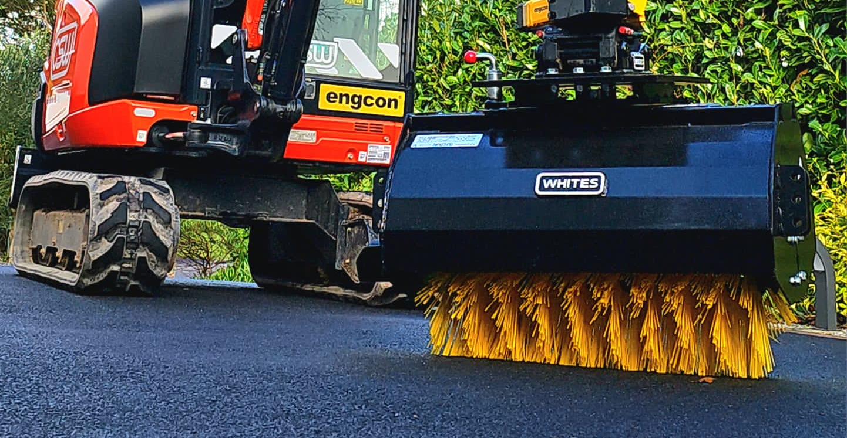
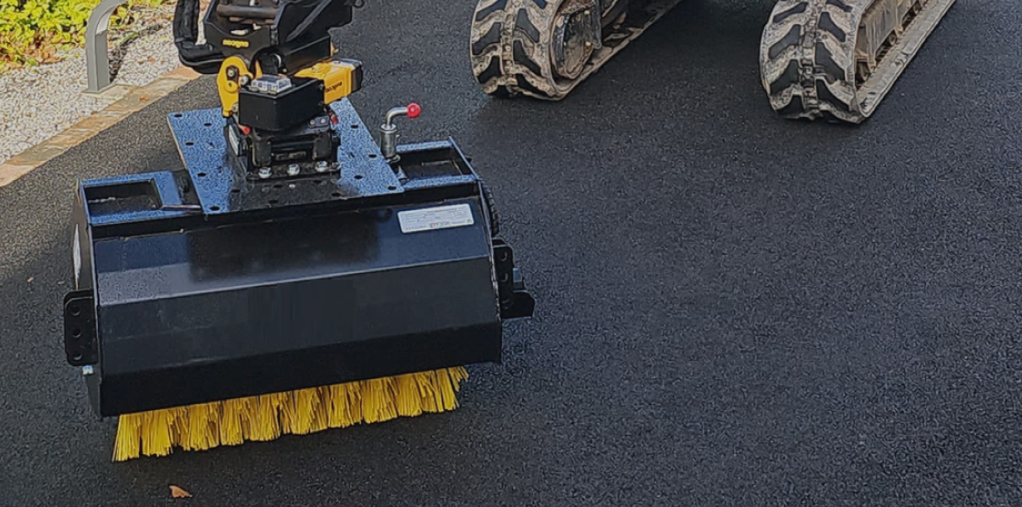

EXCASWEEP
SWEEPER
FEATURES
Powerful direct drive motor inc. pressure relief valve
Hard wearing poly bristles
Universal fitting plate
Stands keep bristles protected when not in use
Covered canopy
30’ manual swivel left/right
WHITES MATERIAL HANDLING
17 - 19 EMERY ROAD
BRISTOL
BS4 5PF
0117 972 0006
WWW.WHITESMH.CO.UK
SALES@WHITESMH.CO.UK

Slide 2
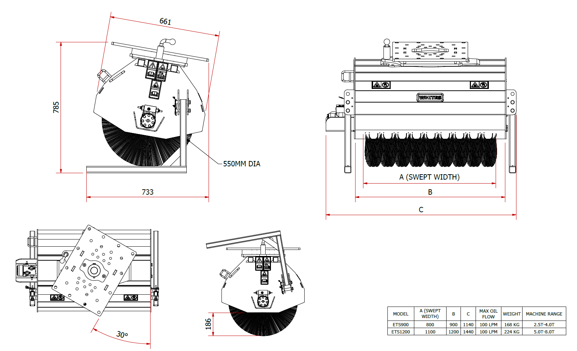
EXCASWEEP
SWEEPER
WHITES MATERIAL HANDLING
17 - 19 EMERY ROAD
BRISTOL
BS4 5PF
0117 972 0006
WWW.WHITESMH.CO.UK
SALES@WHITESMH.CO.UK

