Slide 1

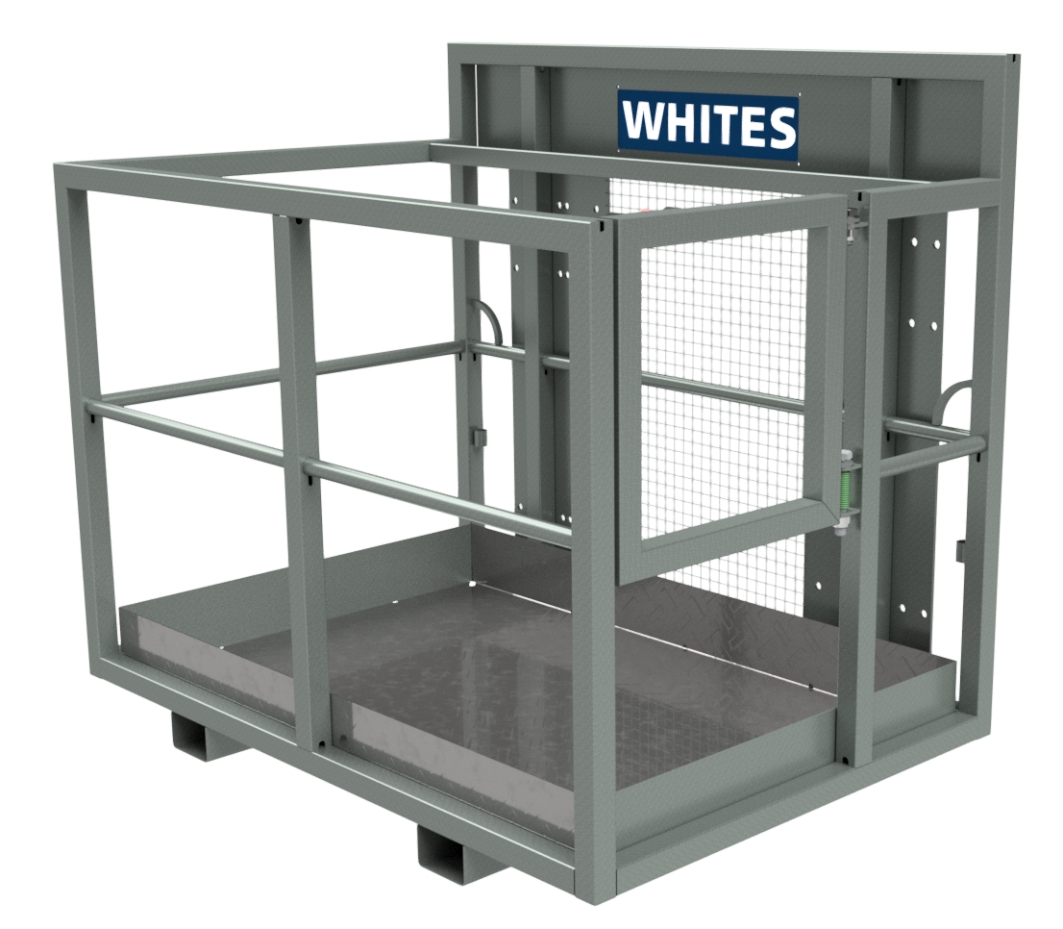





WORK PLATFORMS
FEATURES
Galvanized finish
Two person capacity
Conforms to PM28 guidelines
Self closing gate
Tine slot fixing
Non-slip chequer plate floor
Tool shelf
Harness points
Mesh back
500kg SWL
Optional bolt on loader brackets
Optional personalised name plate
WHITES MATERIAL HANDLING
17 - 19 EMERY ROAD
BRISTOL
BS4 5PF
0117 972 0006
WWW.WHITESMH.CO.UK
SALES@WHITESMH.CO.UK

