Slide 1


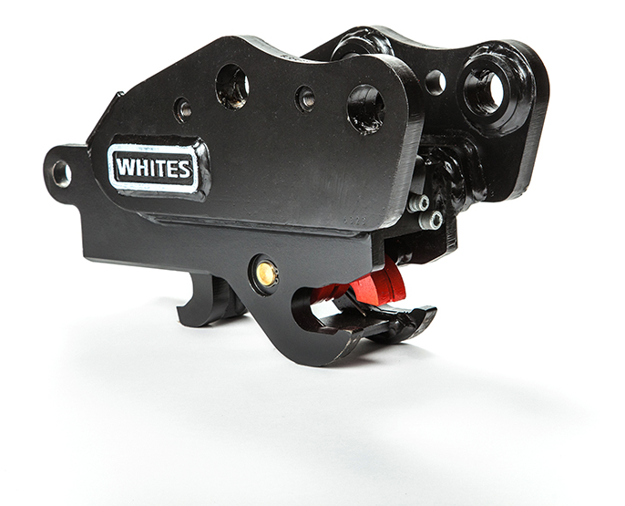




TOTALOCK 2
WHITES MATERIAL HANDLING
17 - 19 EMERY ROAD
BRISTOL
BS4 5PF
0117 972 0006
WWW.WHITESMH.CO.UK
SALES@WHITESMH.CO.UK

Slide 2
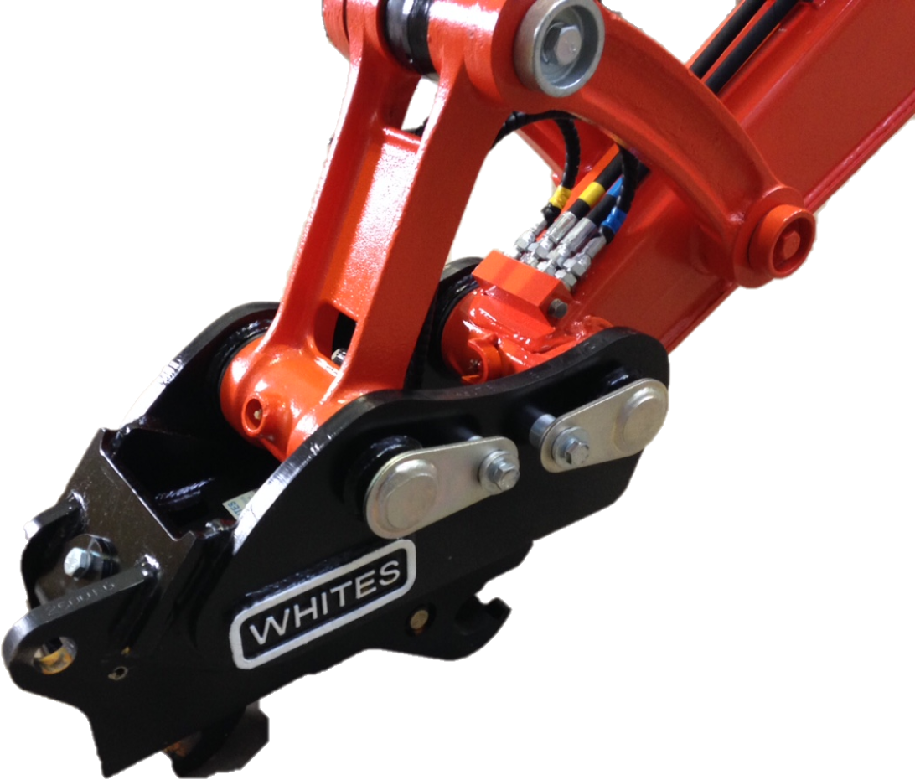
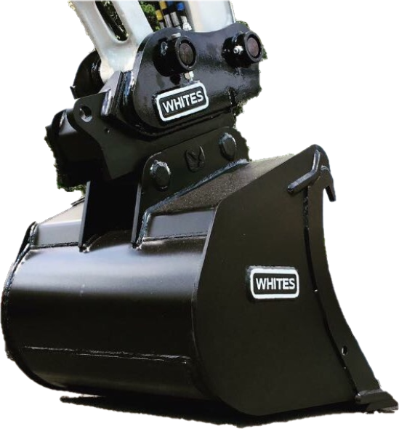
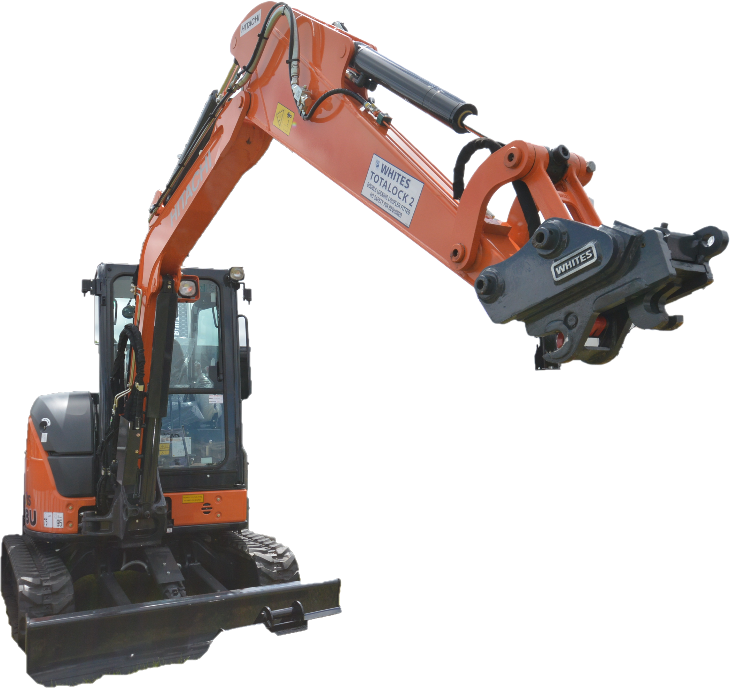

FEATURES
EN474-1 & ISO13031 compliant
Available to suit 0.75 – 22.0 tonne machines
Front & rear safety lock
3-year warranty
Manufactured from RAEX HB400 steel
Compact build height
Tailored fitting solutions
Variable pin centres
Compatible in face mode / reverse
WHITES MATERIAL HANDLING
17 - 19 EMERY ROAD
BRISTOL
BS4 5PF
0117 972 0006
WWW.WHITESMH.CO.UK
SALES@WHITESMH.CO.UK
TOTALOCK 2

Slide 3
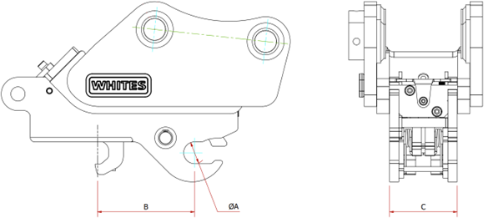
MODELS
Part No. | Machine Capacity | Ø A | B | C
PY25 | < 1.0 tonne | 25mm
PY30 | 1.5 – 3.0 tonne | 30mm
PY35 | 2.5 – 3.5 tonne | 35mm
PY35/40 | 2.5 – 4.0 tonne | 35/40mm
PY40 | 3.0 – 4.0 tonne | 40mm
PY45 | 4.0 – 5.0 tonne | 45mm
PY50 | 5.0 – 10.0 tonne | 50mm
PY55 | 6.0 – 10.0 tonne | 55mm
PY60 | 6.0 – 10.0 tonne | 60mm
PY65 | 13.0 – 15.0 tonne | 65mm
PY80 | 21.0 – 23.0 tonne | 80mm
WHITES MATERIAL HANDLING
17 - 19 EMERY ROAD
BRISTOL
BS4 5PF
0117 972 0006
WWW.WHITESMH.CO.UK
SALES@WHITESMH.CO.UK
TOTALOCK 2

Slide 4
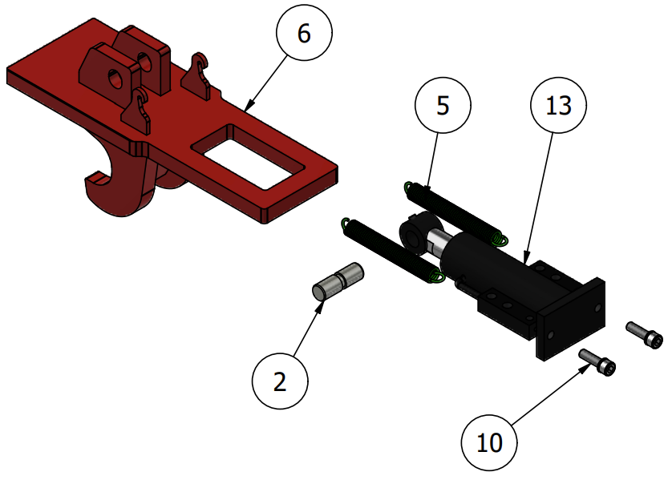
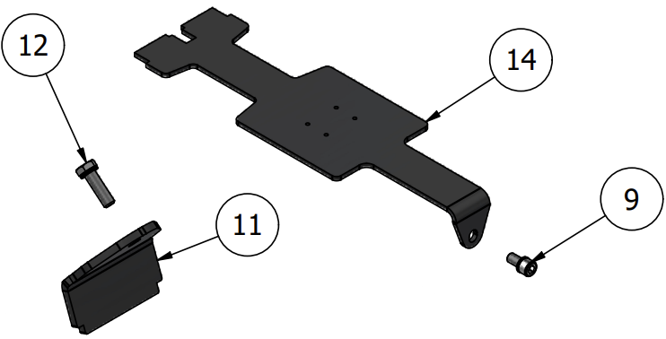
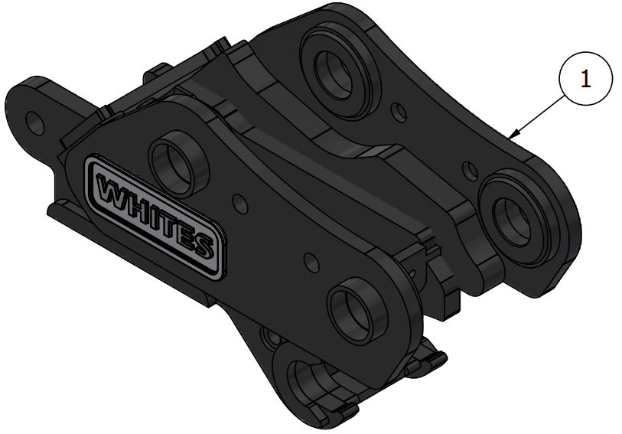
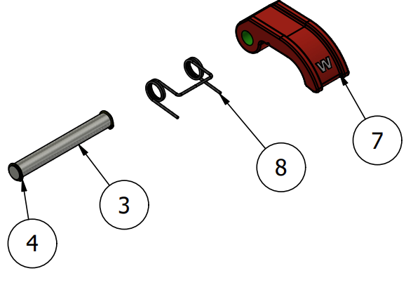
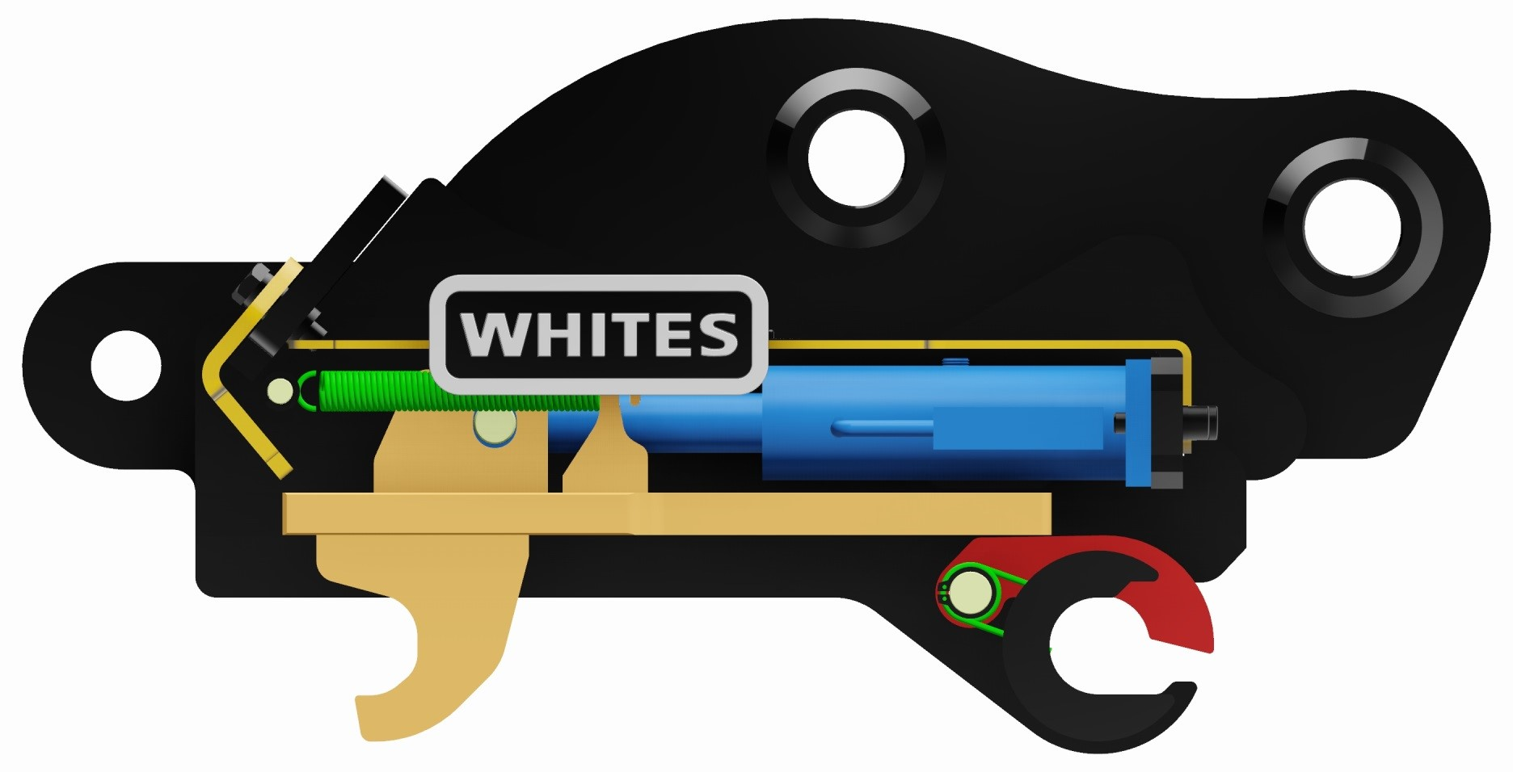
PARTS
Item | QTY. | Description
1 | 1 | Totalock Coupler - WA
2 | 1 | Ram Rod Pin
3 | 1 | Safety Pivot Pin
4 | 2 | External Circlip
5 | 2 | Extension Spring
6 | 1 | Totalock Coupler – Hook
7 | 1 | Totalock Coupler – Safety Fingers
8 | 1 | DBL Torsion Spring
9 | 1 | Top Guard Bolt
10 | 2 | Cylinder Bolt
11 | 1 | Rear Guard
12 | 1 | Rear Guard Bolt
13 | 1 | Hydraulic Cylinder
14 | 1 | Ram Guard
15 | 2 | Spiral Pin
16 | 1 | Flag Bolt (Where Applicable)
WHITES MATERIAL HANDLING
17 - 19 EMERY ROAD
BRISTOL
BS4 5PF
0117 972 0006
WWW.WHITESMH.CO.UK
SALES@WHITESMH.CO.UK
TOTALOCK 2

