Slide 1

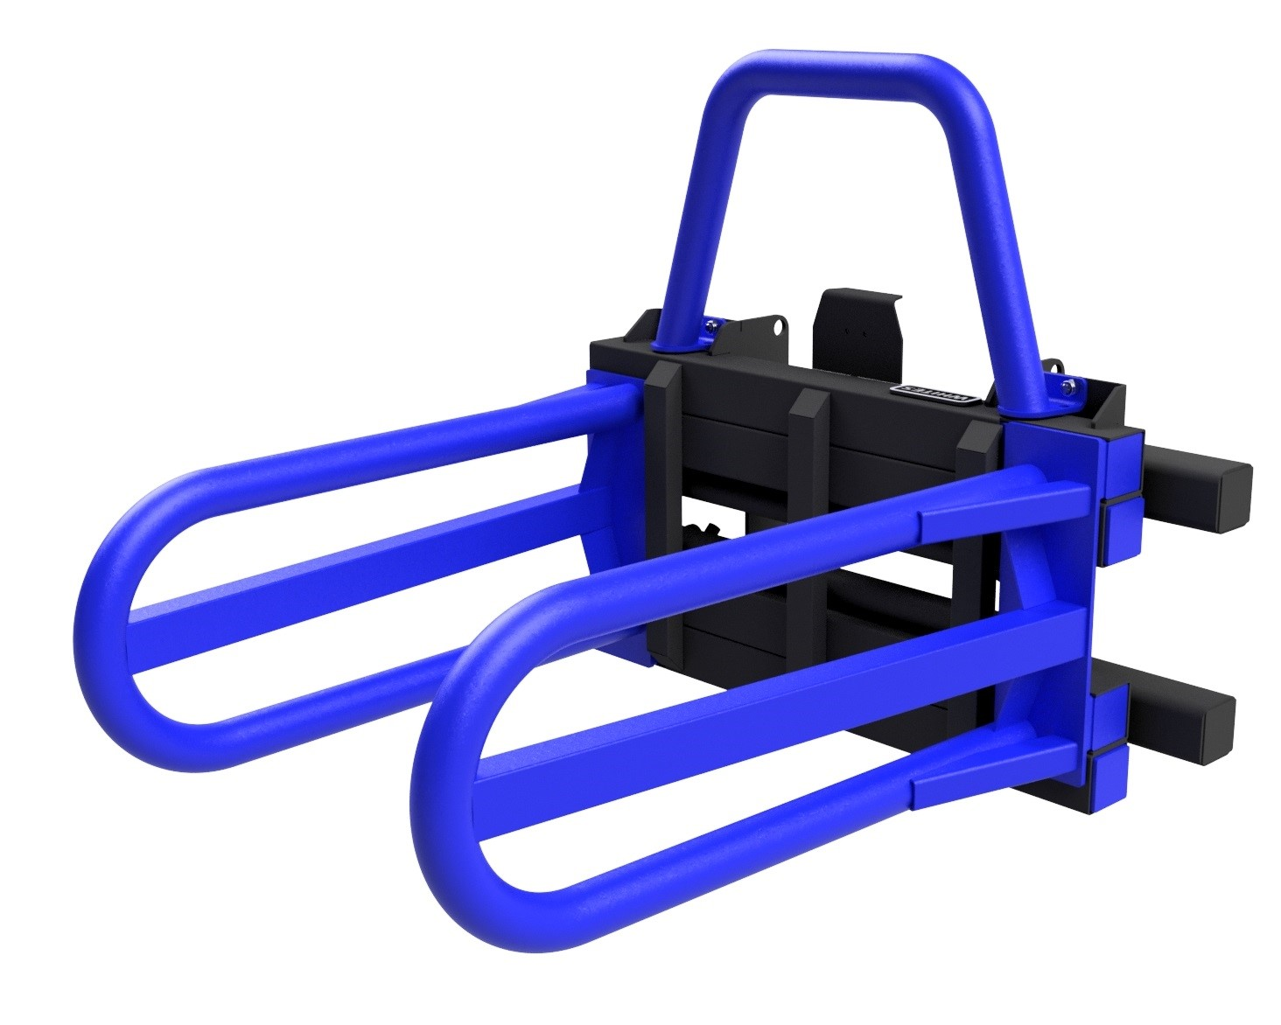
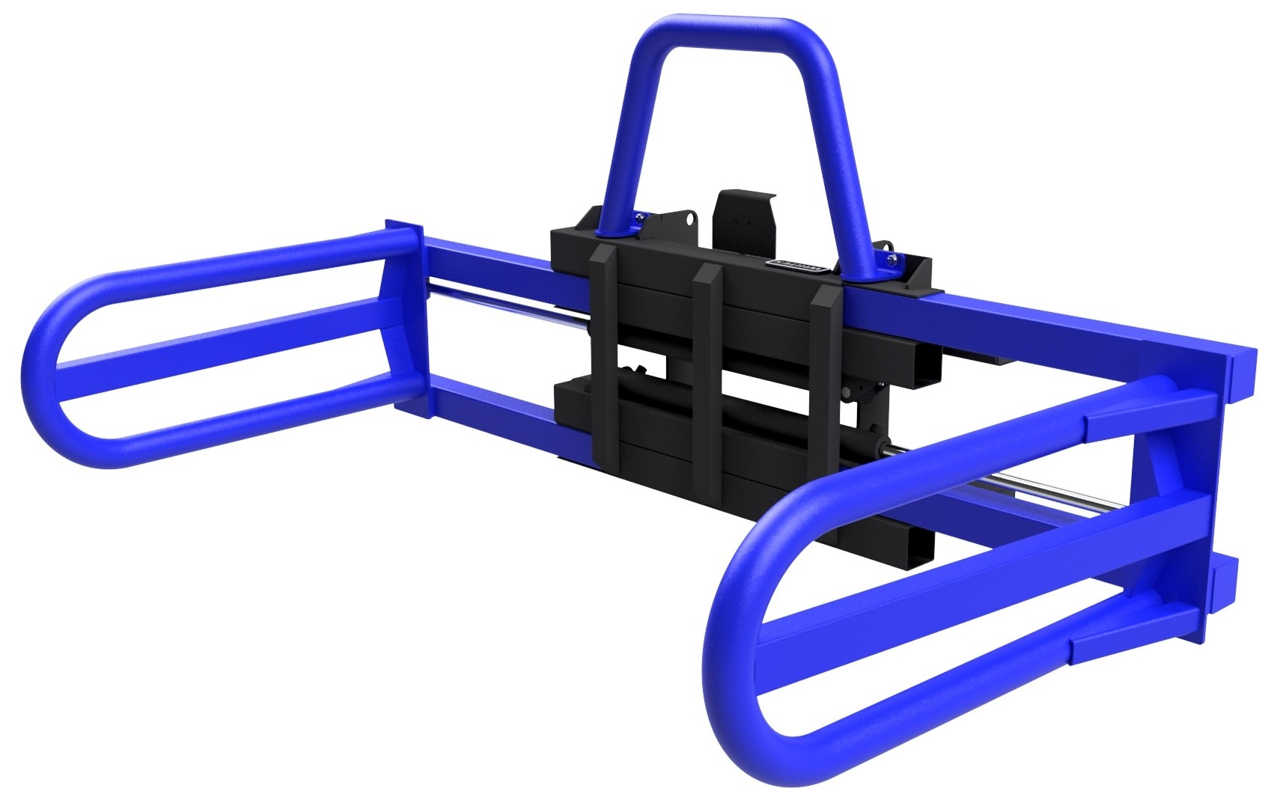





SIDE SQUEEZE
BALE GRAB
FEATURES
Suitable for telehandlers or tractor loaders
Suitable for handling and stacking square & round bales
Turn bales on their end to ‘tub stack’
Round tube arms protect bale wrap
Opens to 2144mm
Closes to 744mm
Second bale spill guard
High grade pivot pins for maximum working life
High capacity cylinder & check valve
High grade WHITES paint finish
Optional bolt on brackets
WHITES MATERIAL HANDLING
17 - 19 EMERY ROAD
BRISTOL
BS4 5PF
0117 972 0006
WWW.WHITESMH.CO.UK
SALES@WHITESMH.CO.UK

