Slide 1

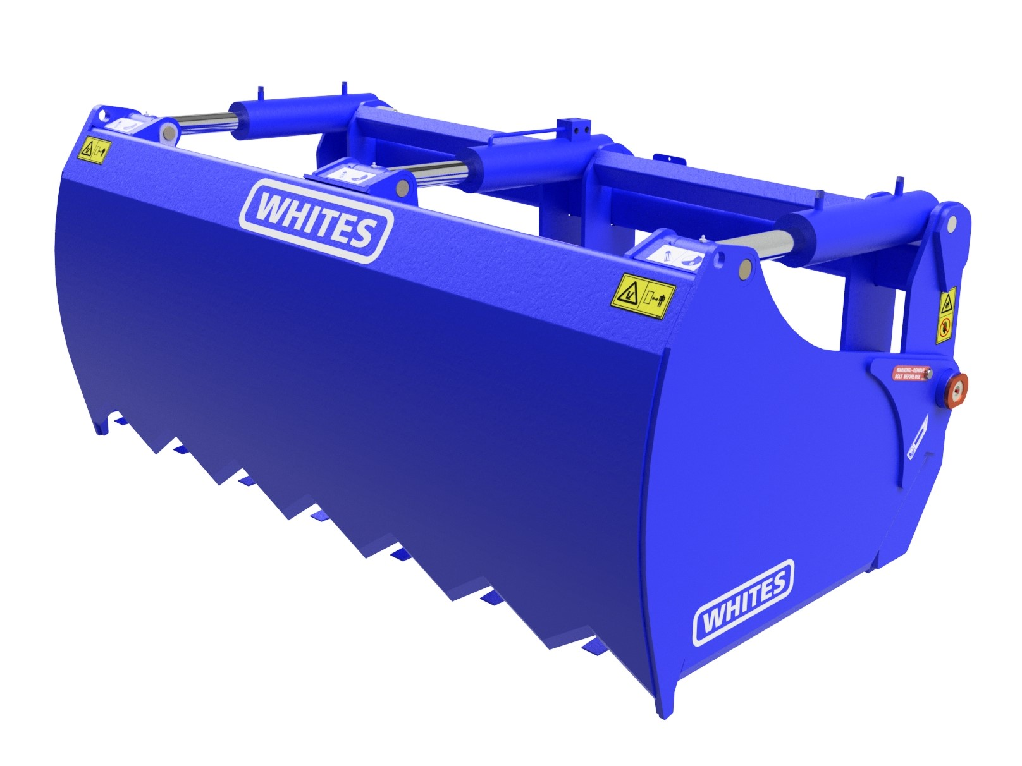
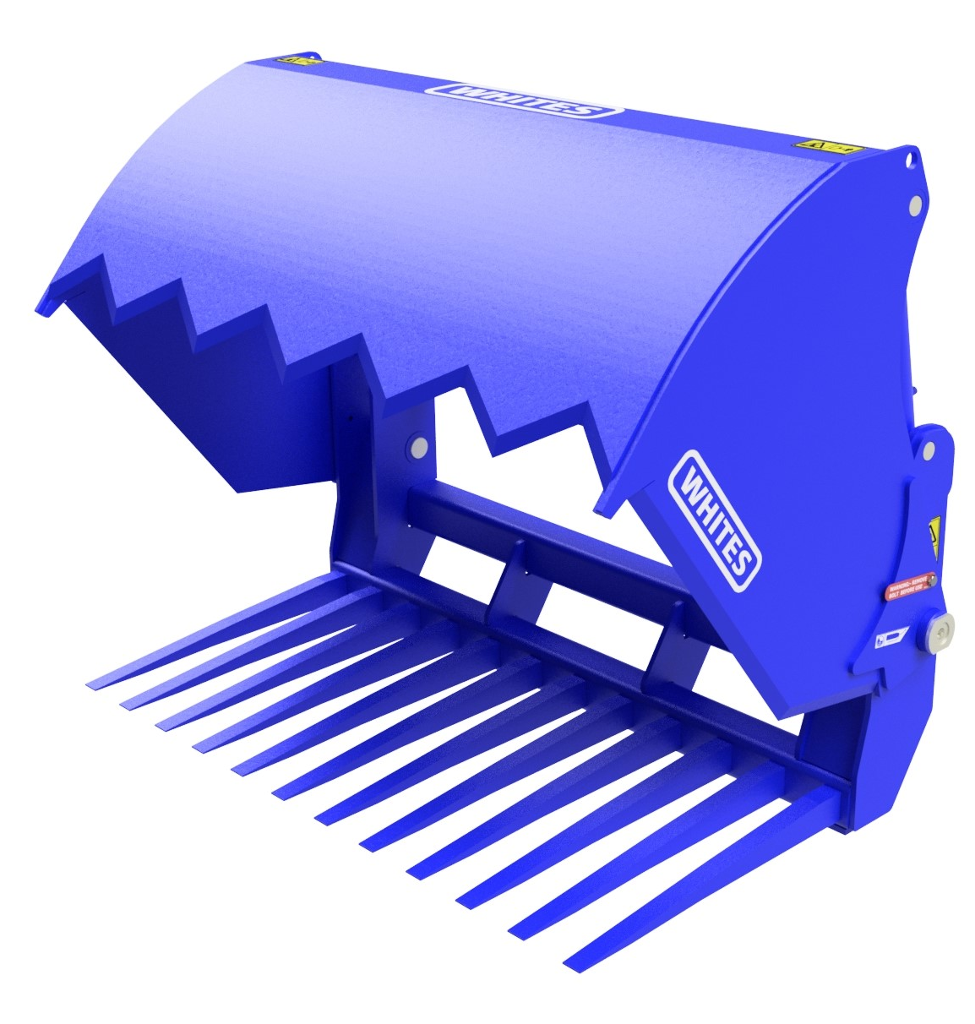





SHEAR GRABS
FEATURES
1600mm & 1900mm wide options
40mm thick Hardox tines
Hardox teeth and side blades
2 & 3 ram options
Protected hose route
1900mm comes with centre cutting knife
High grade paint finish
50mm diameter pivot pin
High grade pins with bushes
High capacity bushed cylinders
Excellent cutting and clamp finish
Bolt on brackets
WHITES MATERIAL HANDLING
17 - 19 EMERY ROAD
BRISTOL
BS4 5PF
0117 972 0006
WWW.WHITESMH.CO.UK
SALES@WHITESMH.CO.UK

