Slide 1

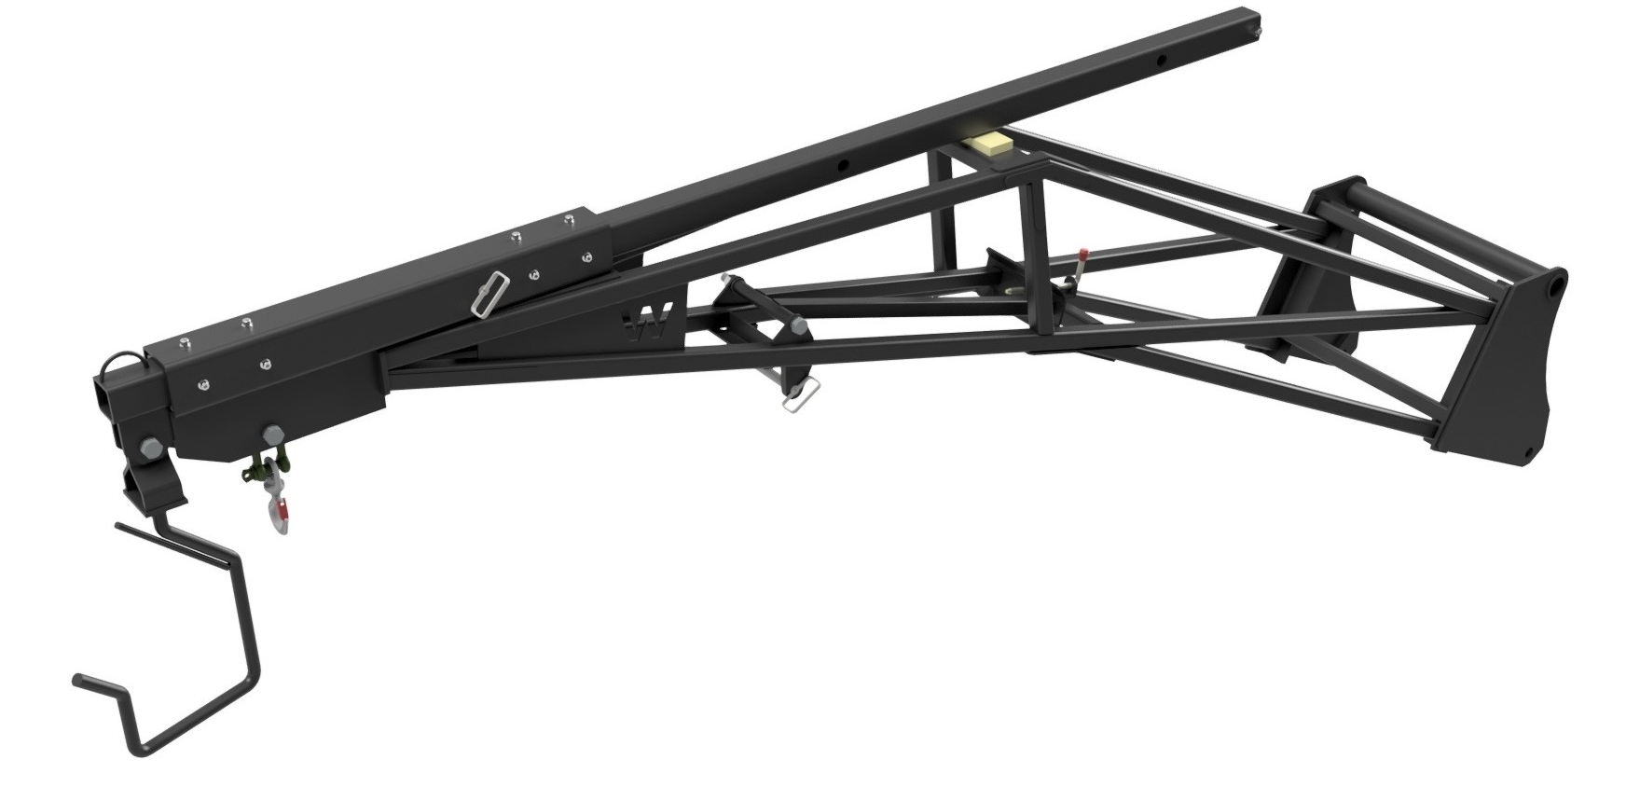
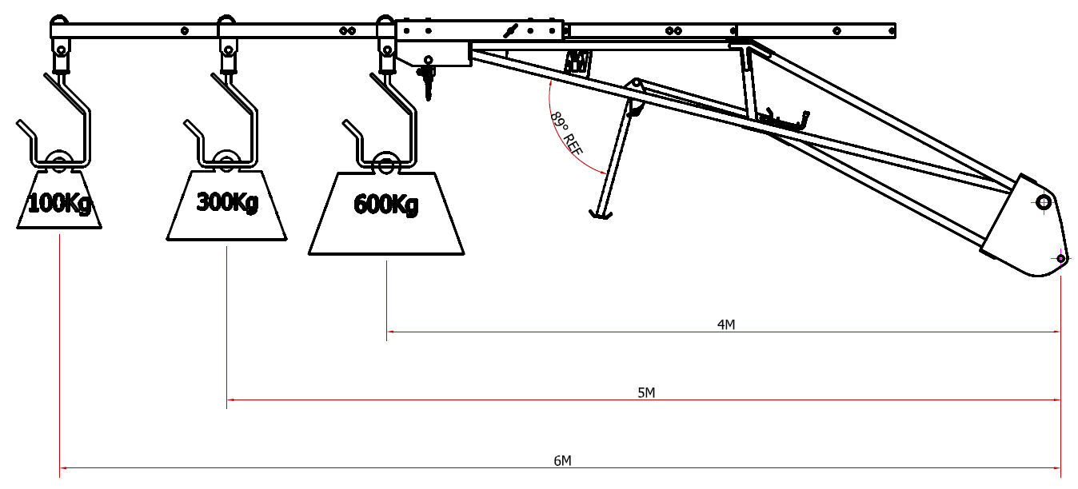




ROOF TRUSS
JIB
FEATURES
Supplied with test certificate
Allows the safe positioning of roof trusses into building
Adjustable from 4 metres - 6 metres
Rated SWL 600KGS
Supplied with D shackle, snap hook and truss hook
Integral parking leg
WHITES MATERIAL HANDLING
17 - 19 EMERY ROAD
BRISTOL
BS4 5PF
0117 972 0006
WWW.WHITESMH.CO.UK
SALES@WHITESMH.CO.UK

