Slide 1

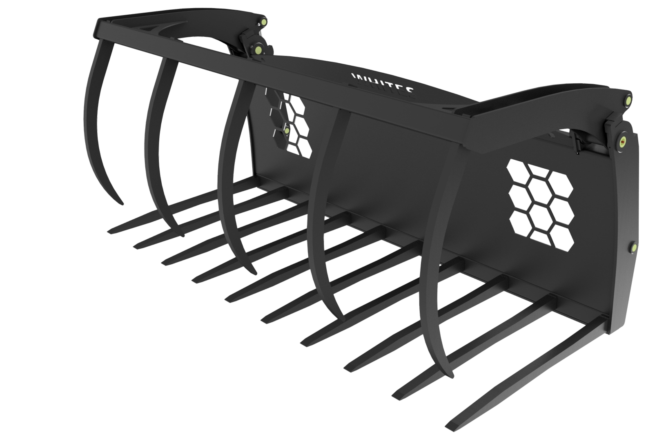





POWERGRABS
FEATURES
Hardox tines
Wide grapple opening
Open and close grab stops for ram and pin protection
High grade pins with bushes
Striking visibility slots
Hose parking slot
Back plate protection for headstock and hydraulics
High capacity hydraulic cylinders
Base wear strip for tine holder protection
Supplied with telehandler mounting brackets
Supplied with hoses and couplings
WHITES MATERIAL HANDLING
17- 19 EMERY ROAD
BRISTOL
BS4 5PF
0117 972 0006
WWW.WHITESMH.CO.UK
SALES@WHITESMH.CO.UK

