Slide 1

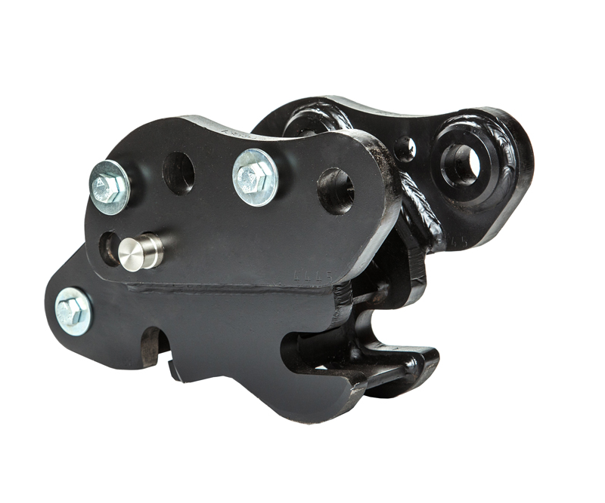




MANUAL
SPRINGLOCK
COUPLERS
WHITES MATERIAL HANDLING
17 - 19 EMERY ROAD
BRISTOL
BS4 5PF
0117 972 0006
WWW.WHITESMH.CO.UK
SALES@WHITESMH.CO.UK

Slide 2
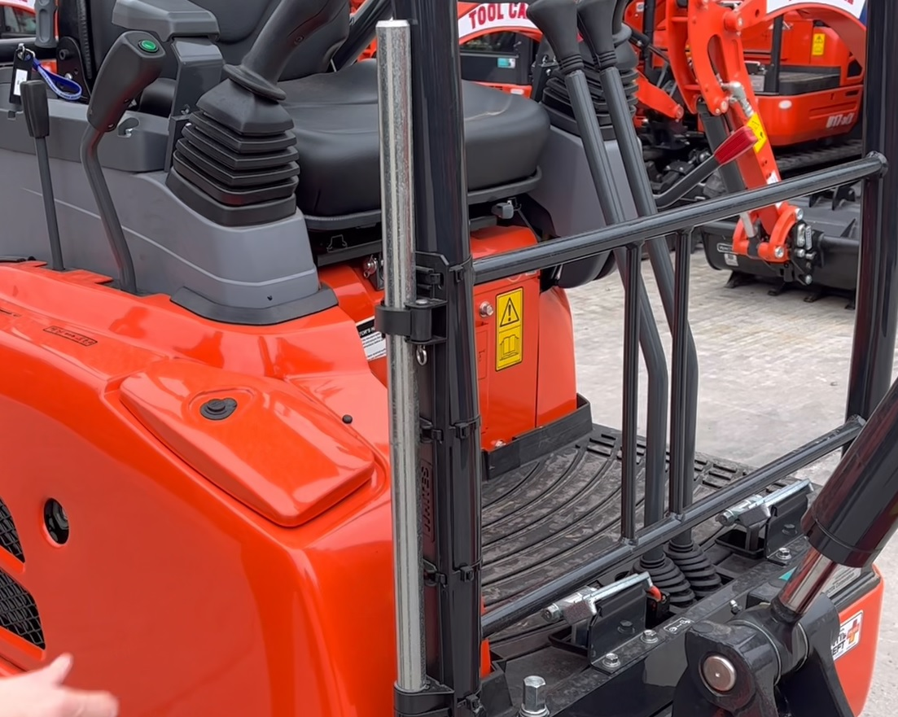
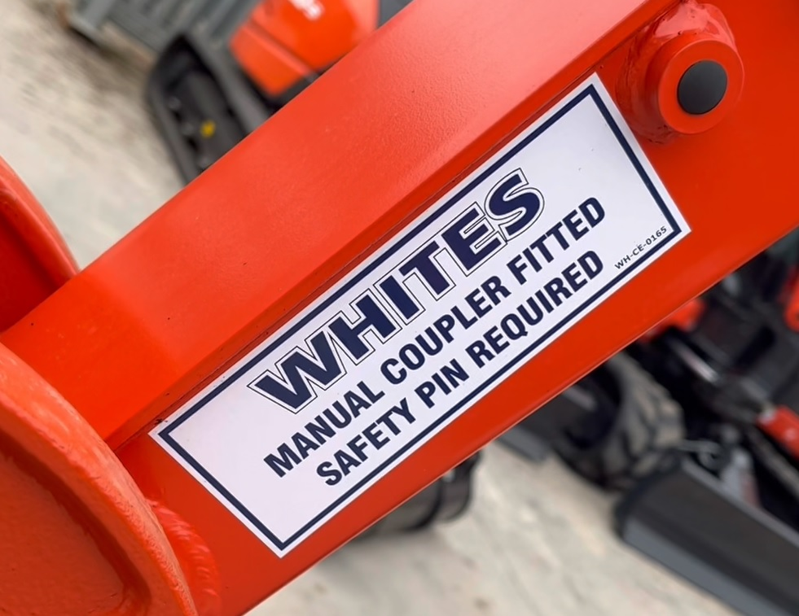
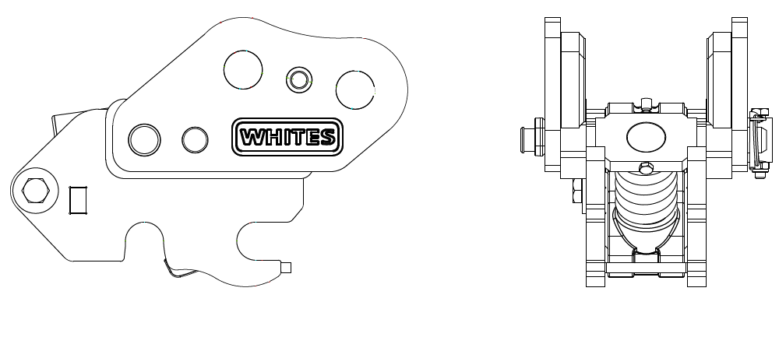
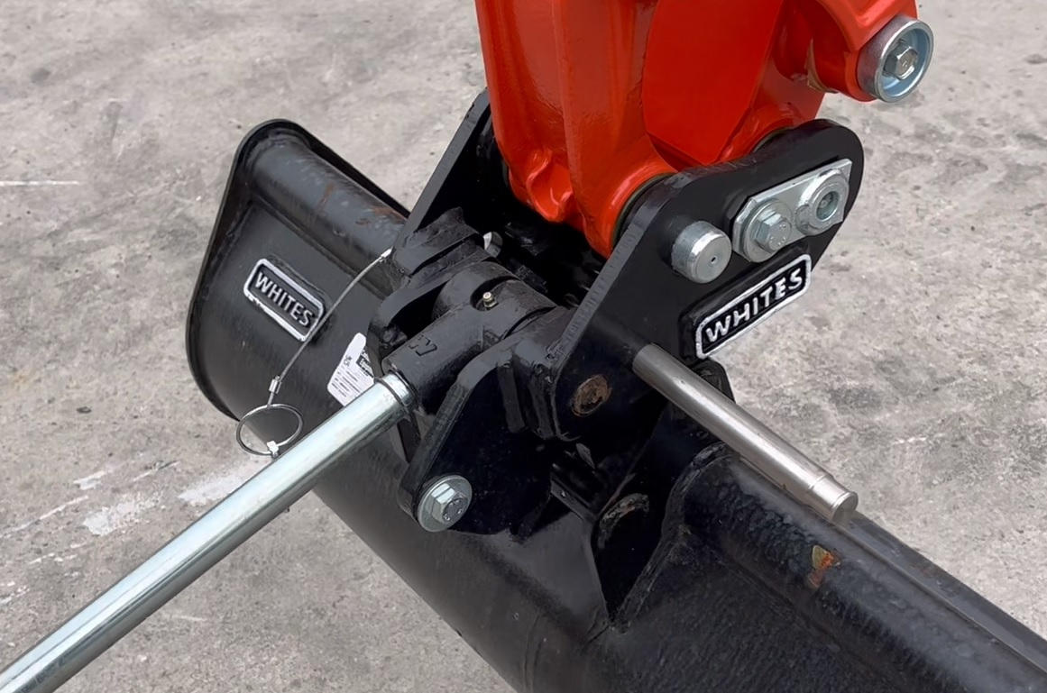

FEATURES
UK market share leader
RAEX 500 base plates
Simple sprung release and locking mechanism
Integrated lifting eye
Fully retained safety pin
Powerful oversized locking spring
Models available for a variety of machines and models
Mix match options available
Compact build height
Compatible in rear/face mode
WHITES MATERIAL HANDLING
17 - 19 EMERY ROAD
BRISTOL
BS4 5PF
0117 972 0006
WWW.WHITESMH.CO.UK
SALES@WHITESMH.CO.UK
MANUAL
SPRINGLOCK COUPLERS

