Slide 1

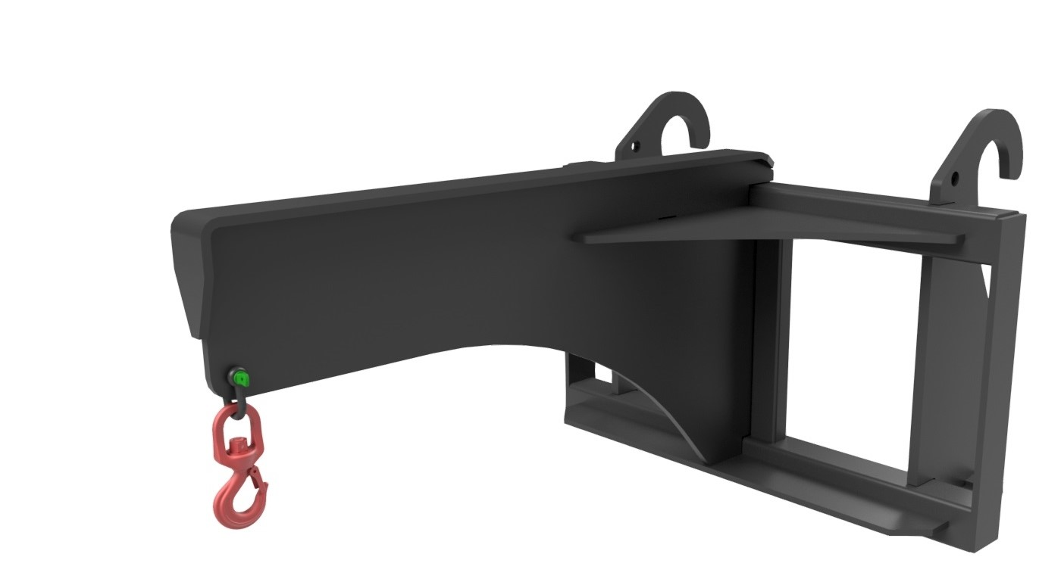




LIFTING
JIB
FEATURES
Supplied with test certificate
Direct mounting brackets
Heavy build
D-shackle and swivel lifting hook
1 tonne & 2 tonne lift capacities
WHITES MATERIAL HANDLING
17 - 19 EMERY ROAD
BRISTOL
BS4 5PF
0117 972 0006
WWW.WHITESMH.CO.UK
SALES@WHITESMH.CO.UK

