Slide 1

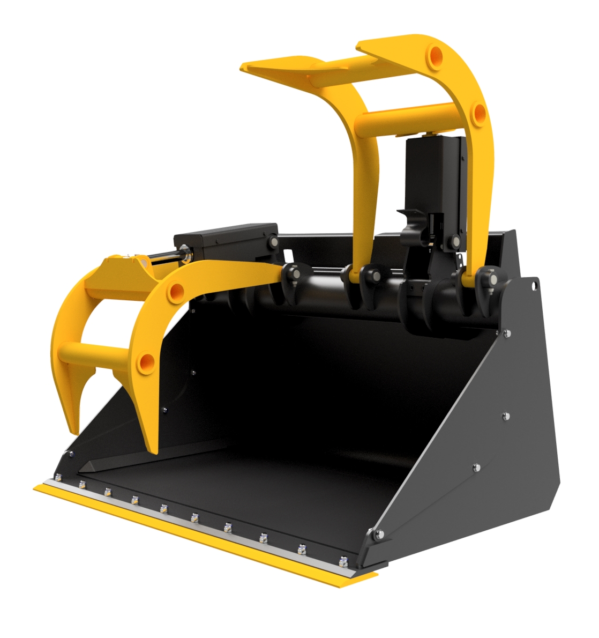
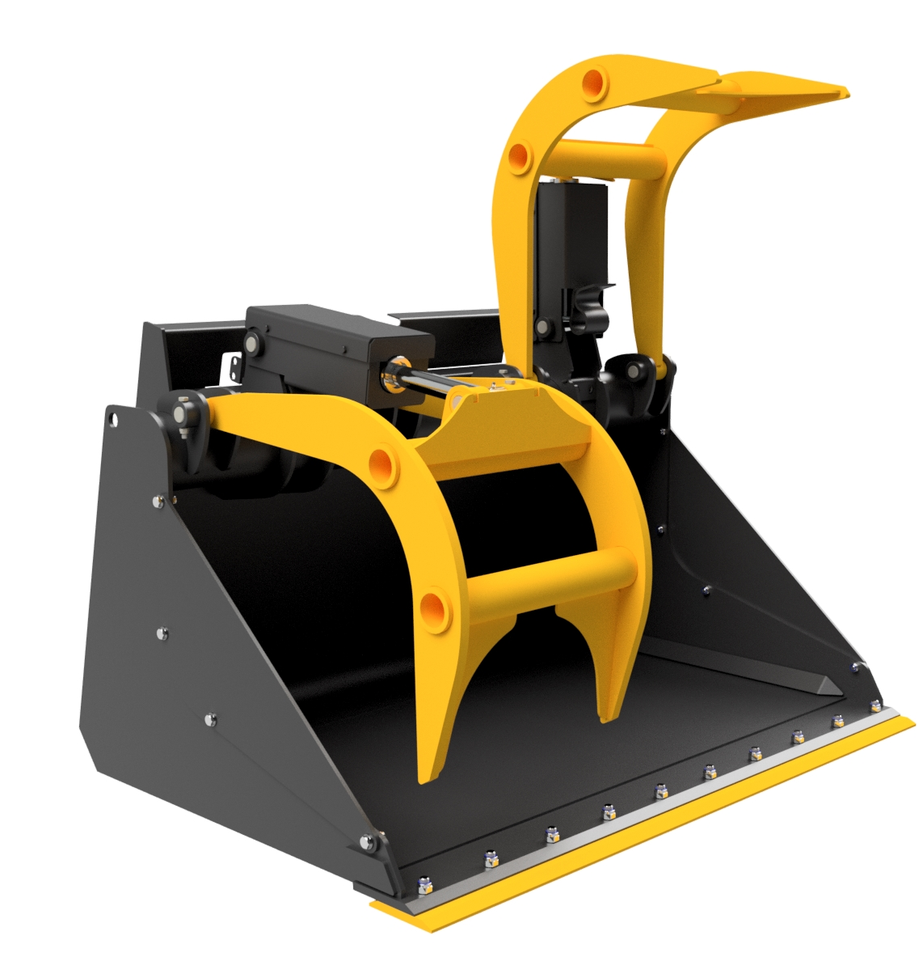





JCB TELETRUK
GRAB
BUCKET
FEATURES
Specifically designed for JCB Teletruk
1525mm / 5’ wide
0.85m3
900mm (h) x 1000mm (d)
1395mm grab opening
Split grab – ideal for uneven loads
Bolt on reversible toe plate
Removable side panels
Outer Hardox wear pads
Ram bodies & hoses guarded
Available with Class 3 or Changeeze brackets
Supplied with hoses
Optional plate across grab tips
Model | Width | Capacity
IGTT1525 | 5’ / 1525m3 | 0.85m3
WHITES MATERIAL HANDLING
17 - 19 EMERY ROAD
BRISTOL
BS4 5PF
0117 972 0006
WWW.WHITESMH.CO.UK
SALES@WHITESMH.CO.UK

