Slide 1

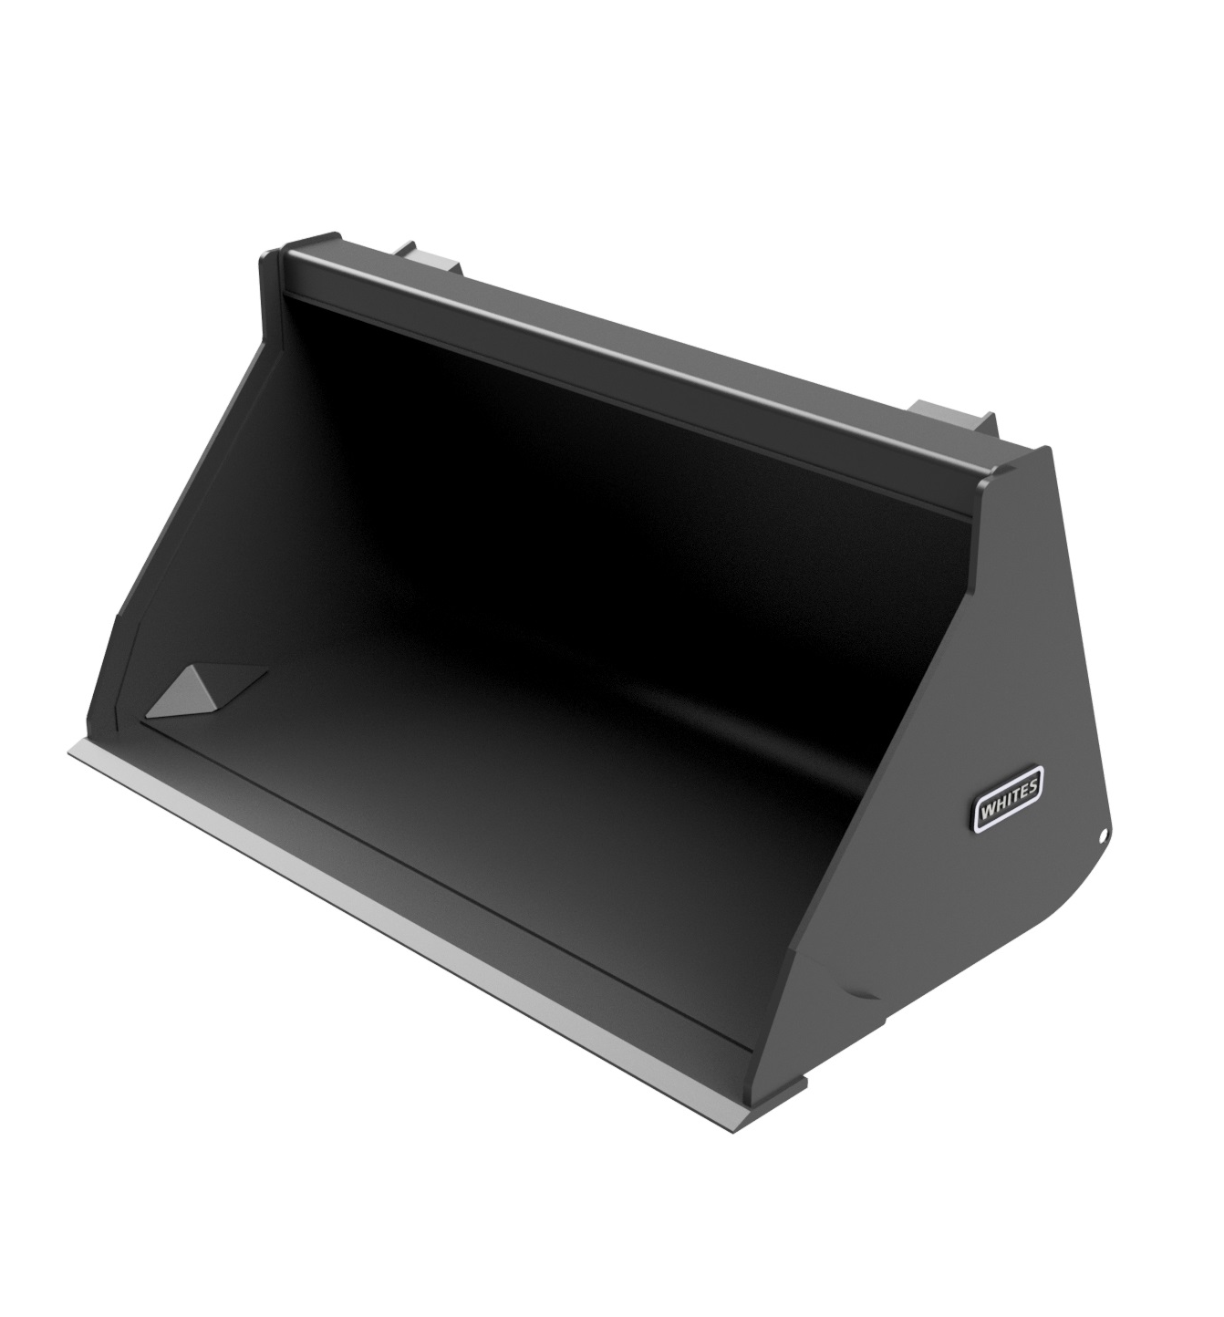





JCB TELETRUK
GP
BUCKET
FEATURES
Specifically designed for JCB Teletruk
1525mm / 5’ wide
0.60m3
HB500 cutting edge and heel pads
Available with Class 3 or Changeeze brackets
Optional bolt on reversible toe plate
Model | Width | Capacity
GP0650X3 | 5’ / 1525m3 | 0.60m3
WHITES MATERIAL HANDLING
17 - 19 EMERY ROAD
BRISTOL
BS4 5PF
0117 972 0006
WWW.WHITESMH.CO.UK
SALES@WHITESMH.CO.UK

