Slide 1
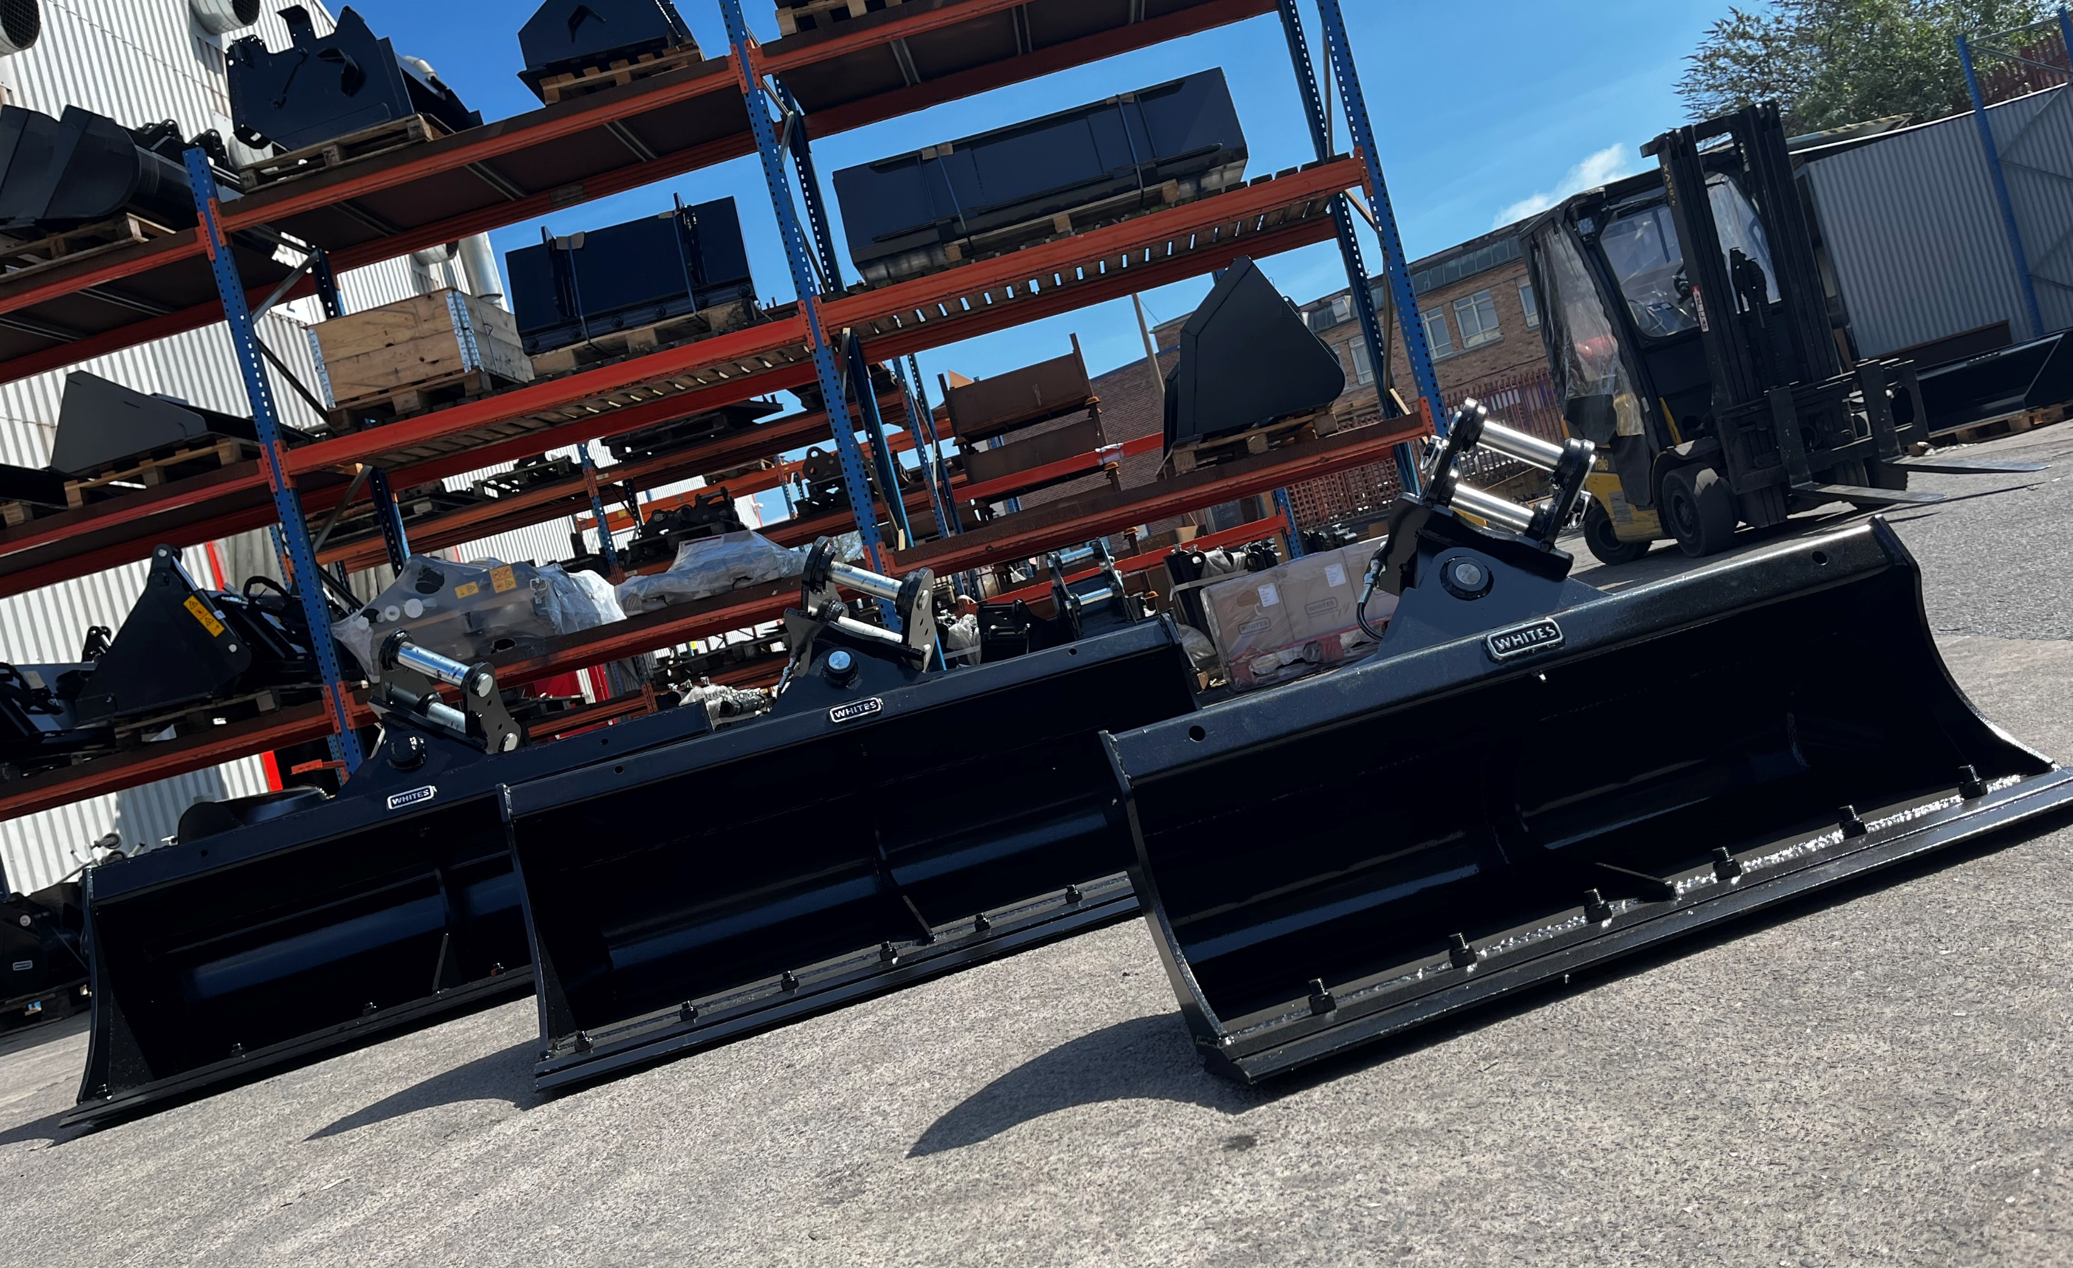

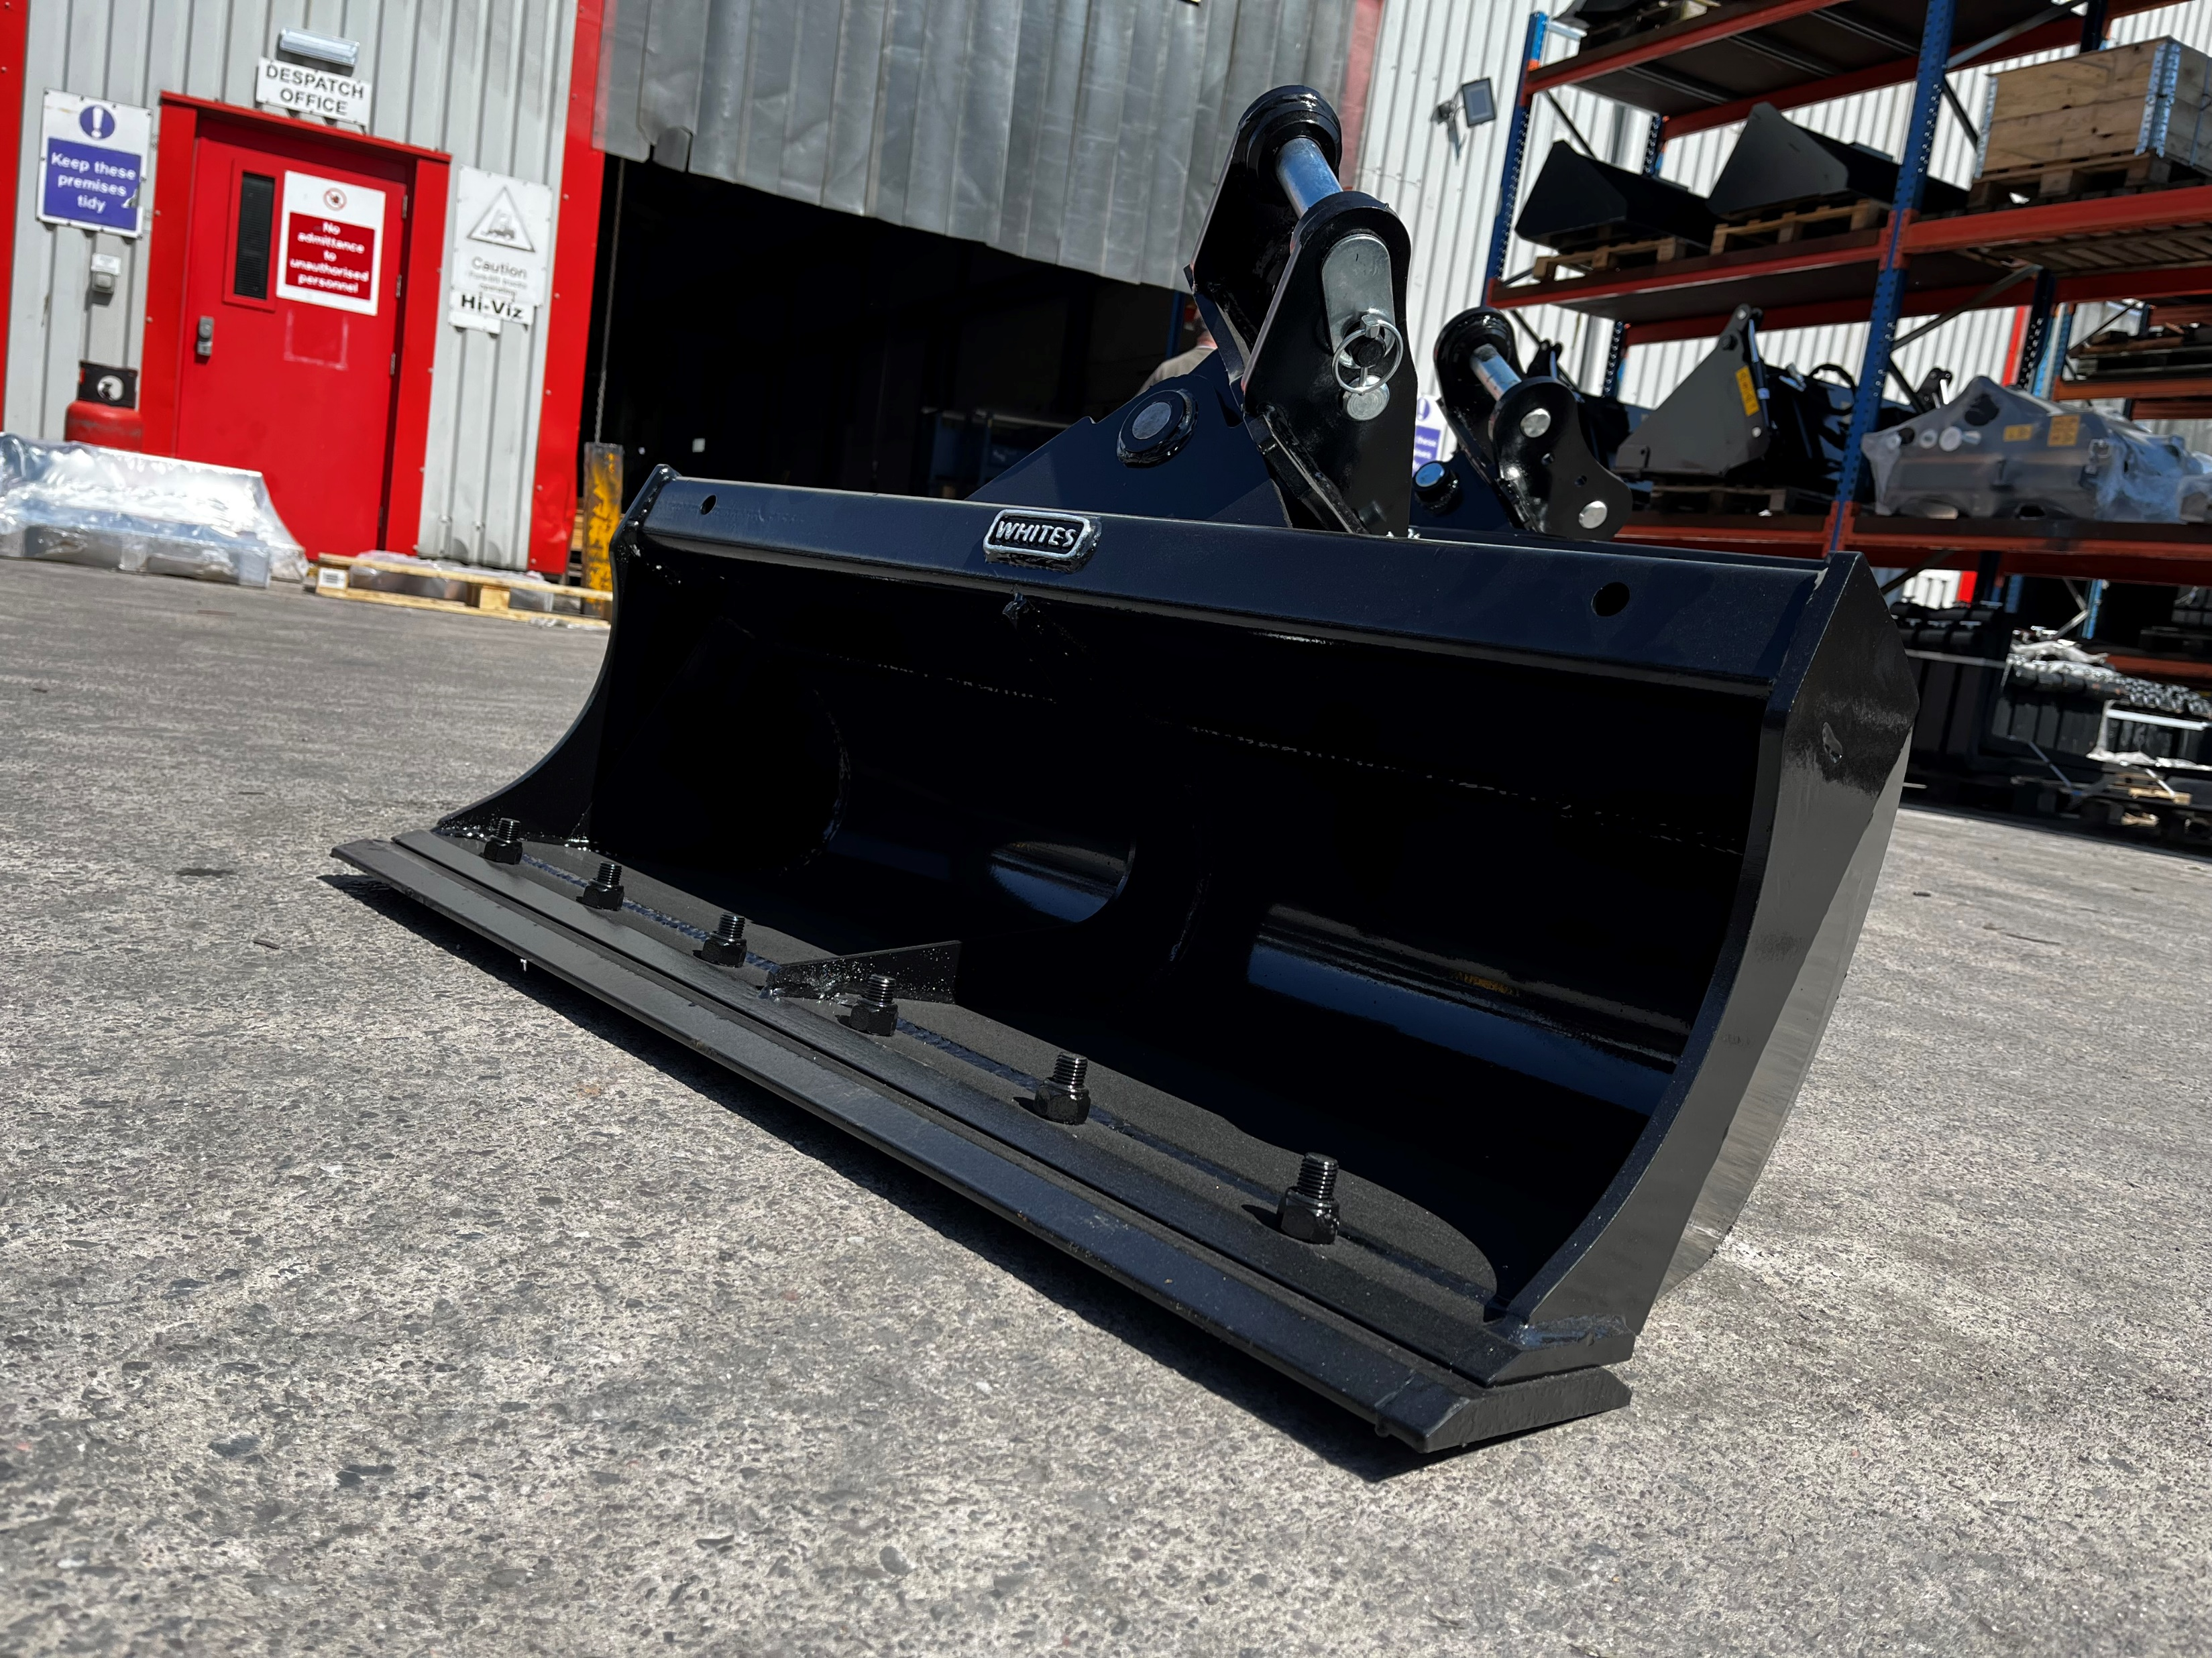

HYDRAULIC
TILT DITCHING BUCKET
FEATURES
45° rotation left and right
Large hydraulic cylinders provide smooth operation
Hardened bushes in main pivot
Check valve to stop hydraulic creeping
Hoses to bulkhead provided
Bolt on reversible toe plate on 1.5 tonne + models
WHITES MATERIAL HANDLING
17 - 19 EMERY ROAD
BRISTOL
BS4 5PF
0117 972 0006
WWW.WHITESMH.CO.UK
SALES@WHITESMH.CO.UK

Slide 2
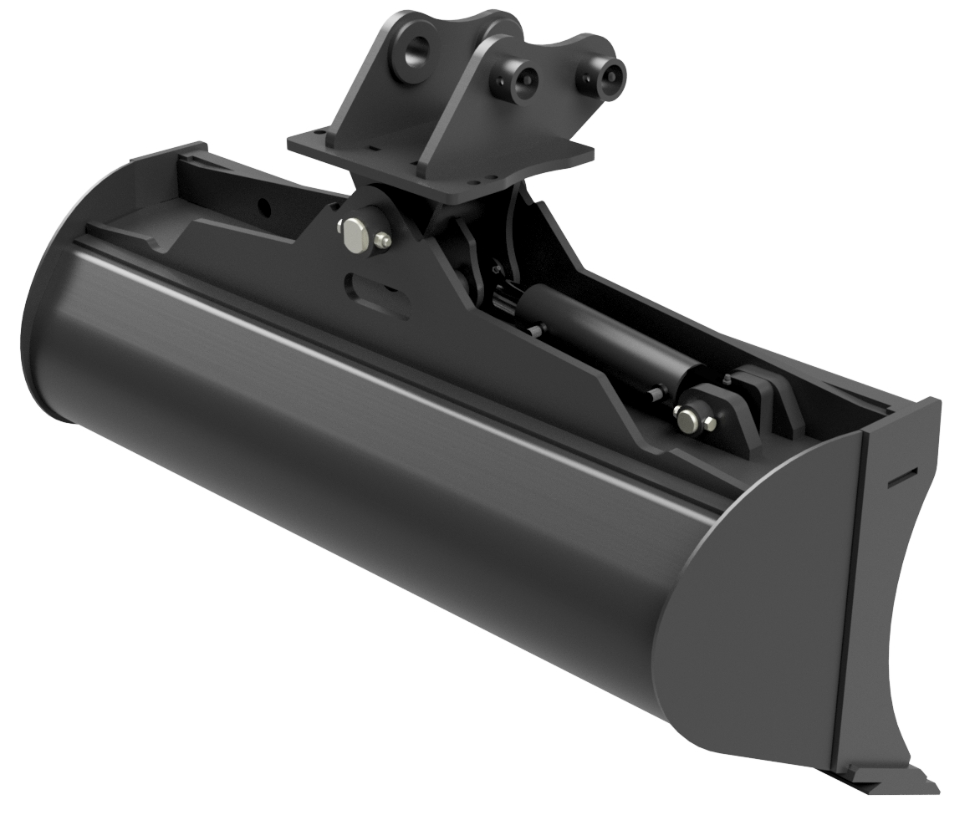
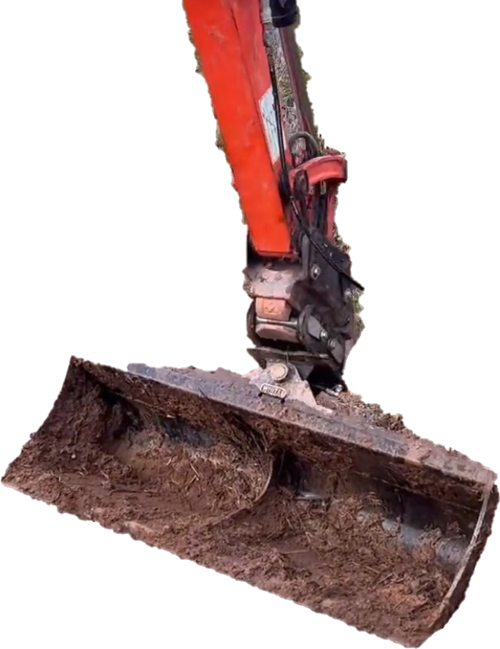
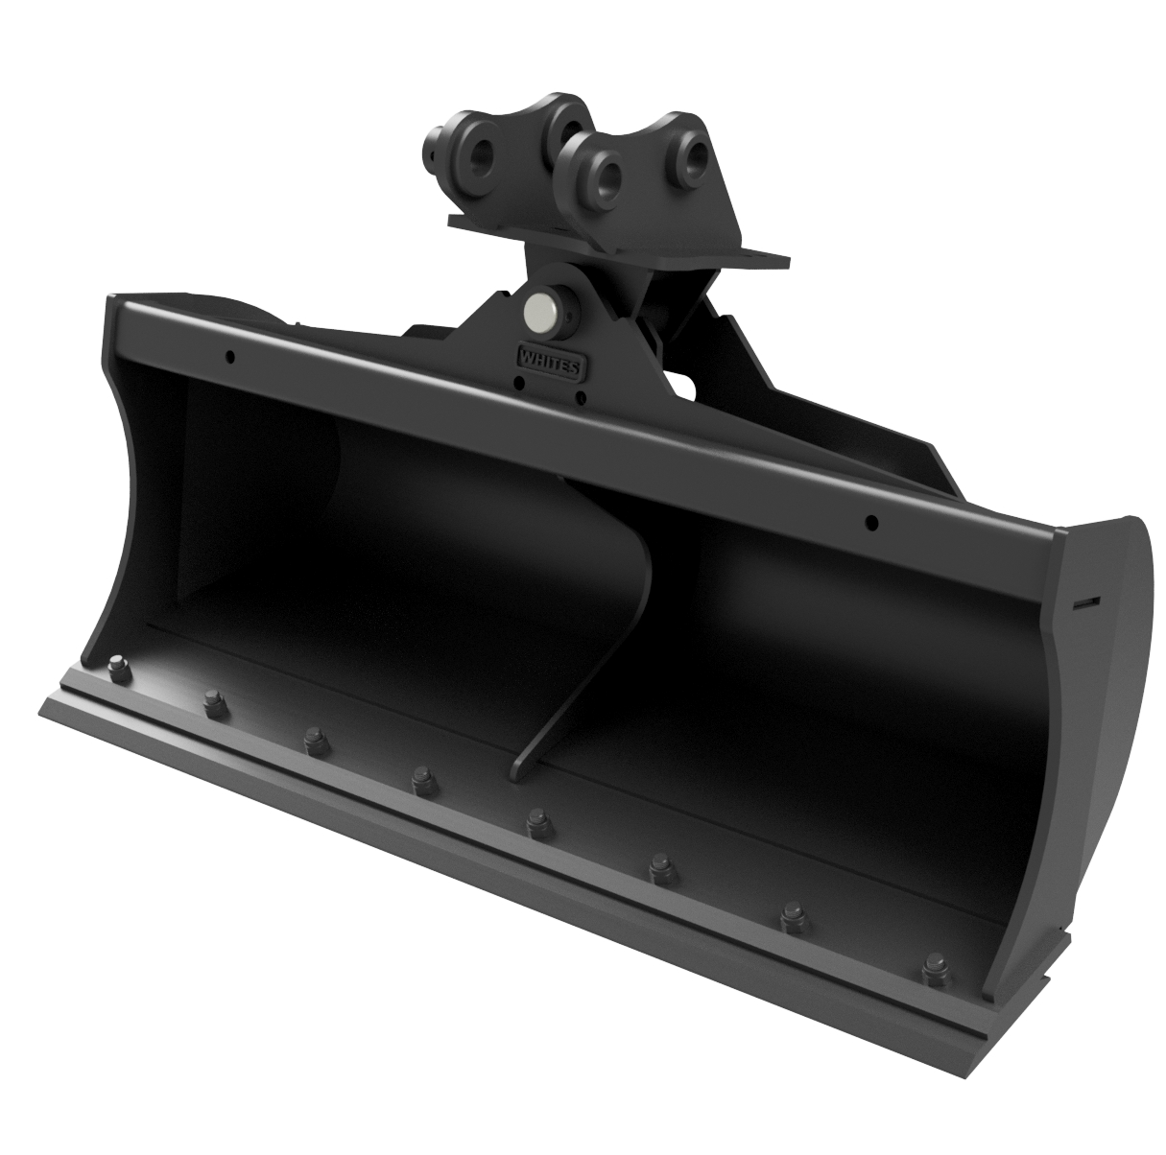
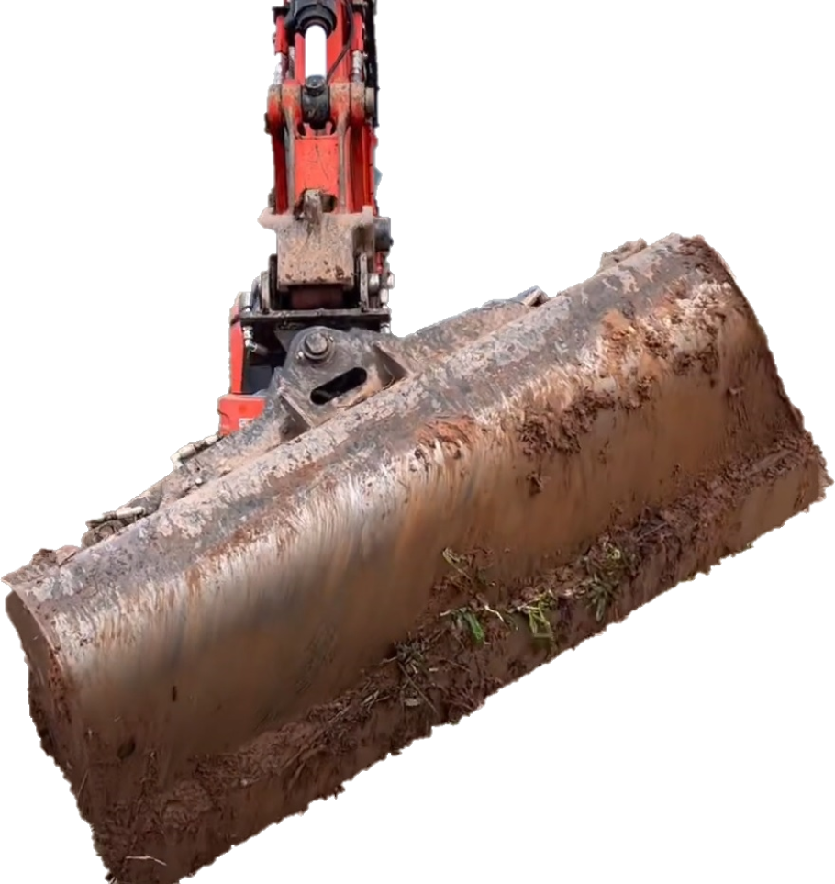
HYDRAULIC
TILT DITCHING BUCKET
Part No. | Weight Range | Description | Width (mm) | Width (in) | Cylinders
EWST0836 | 0.75T | TILT DITCH BUCKET | 900 | 36 | 1
EWST1536 | 1.5T | TILT DITCH BUCKET W/ RBOC | 900 | 36 | 1
EWST1539 | 1.5T | TILT DITCH BUCKET W/ RBOC | 1000 | 39 | 1
EWST3039 | 3.0T | TILT DITCH BUCKET W/ RBOC | 1000 | 39 | 1
EWST3048 | 3.0T | TILT DITCH BUCKET W/ RBOC | 1200 | 48 | 1
EWST4048 | 4.0T | TILT DITCH BUCKET W/ RBOC | 1200 | 48 | 1
EWST4054 | 4.0T | TILT DITCH BUCKET W/ RBOC | 1370 | 54 | 1
EWST5548 | 5.5T | TILT DITCH BUCKET W/ RBOC | 1200 | 48 | 2
EWST5560 | 5.5T | TILT DITCH BUCKET W/ RBOC | 1500 | 60 | 2
EWST7060 | 7.0-9.0T | TILT DITCH BUCKET W/ RBOC | 1500 | 60 | 2
EWST7072 | 7.0-9.0T | TILT DITCH BUCKET W/ RBOC | 1850 | 72 | 2
QWGP1372 | 13-15.0T | TILT DITCH BUCKET W/ RBOC | 1850 | 72 | 2
QWGP2184 | 21.0T | TILT DITCH BUCKET W/ RBOC | 2130 | 84 | 2
WHITES MATERIAL HANDLING
17 - 19 EMERY ROAD
BRISTOL
BS4 5PF
0117 972 0006
WWW.WHITESMH.CO.UK
SALES@WHITESMH.CO.UK

