Slide 1

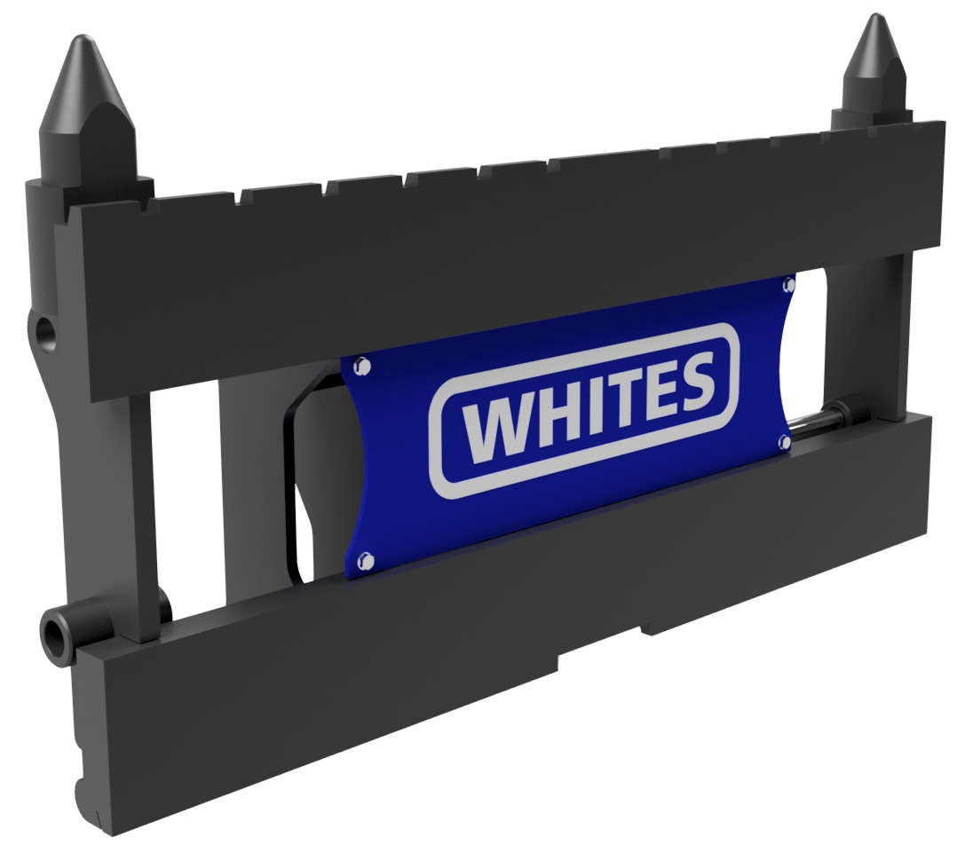
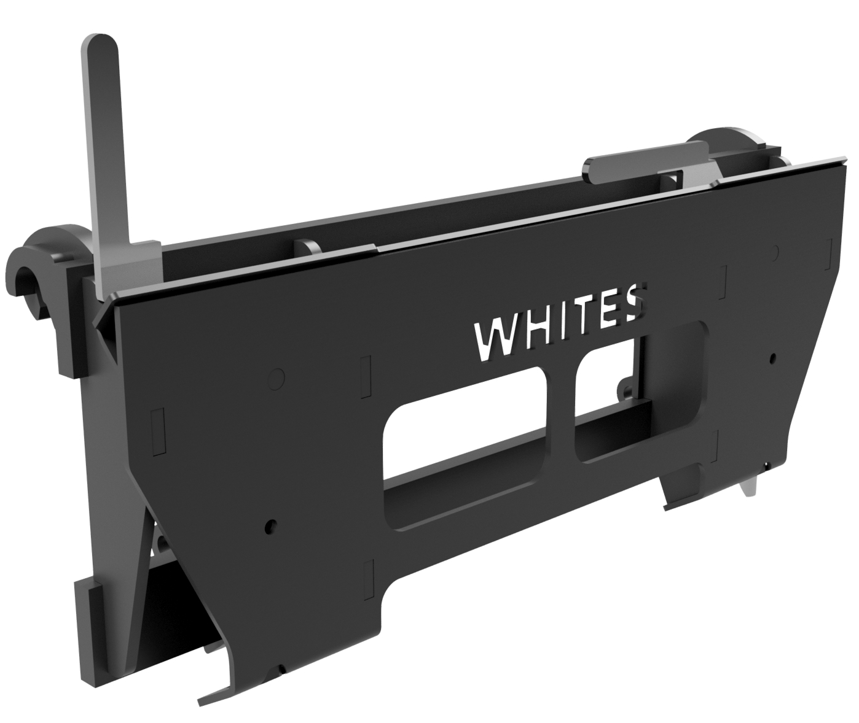
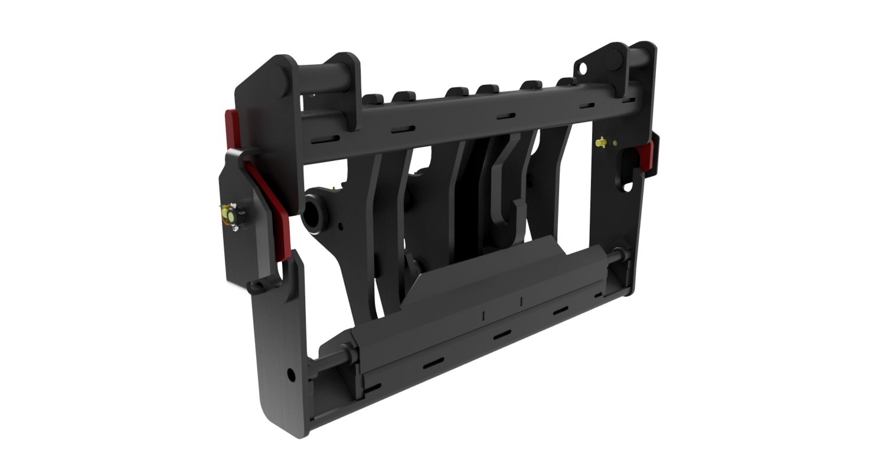
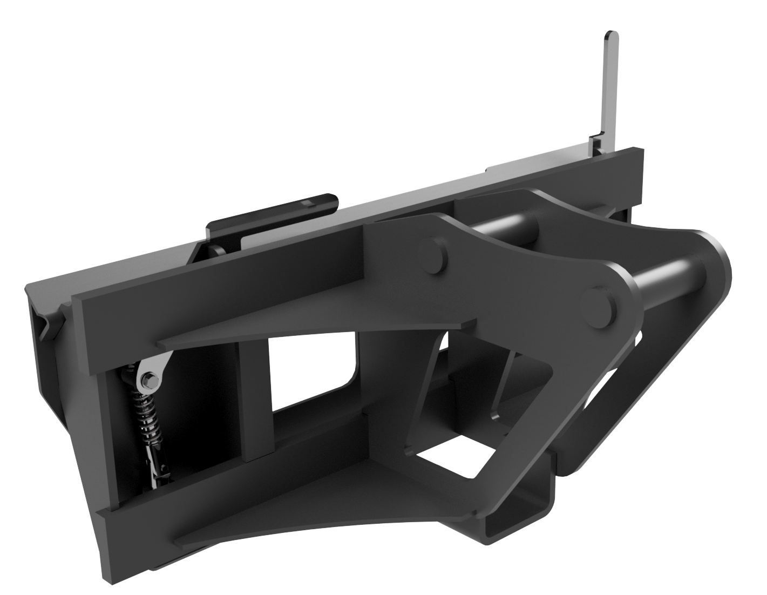
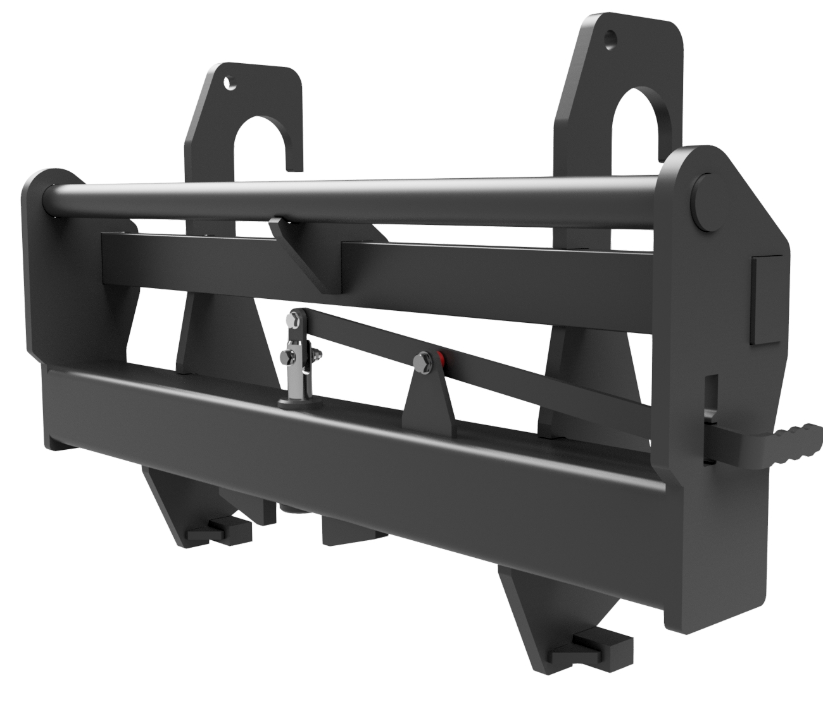
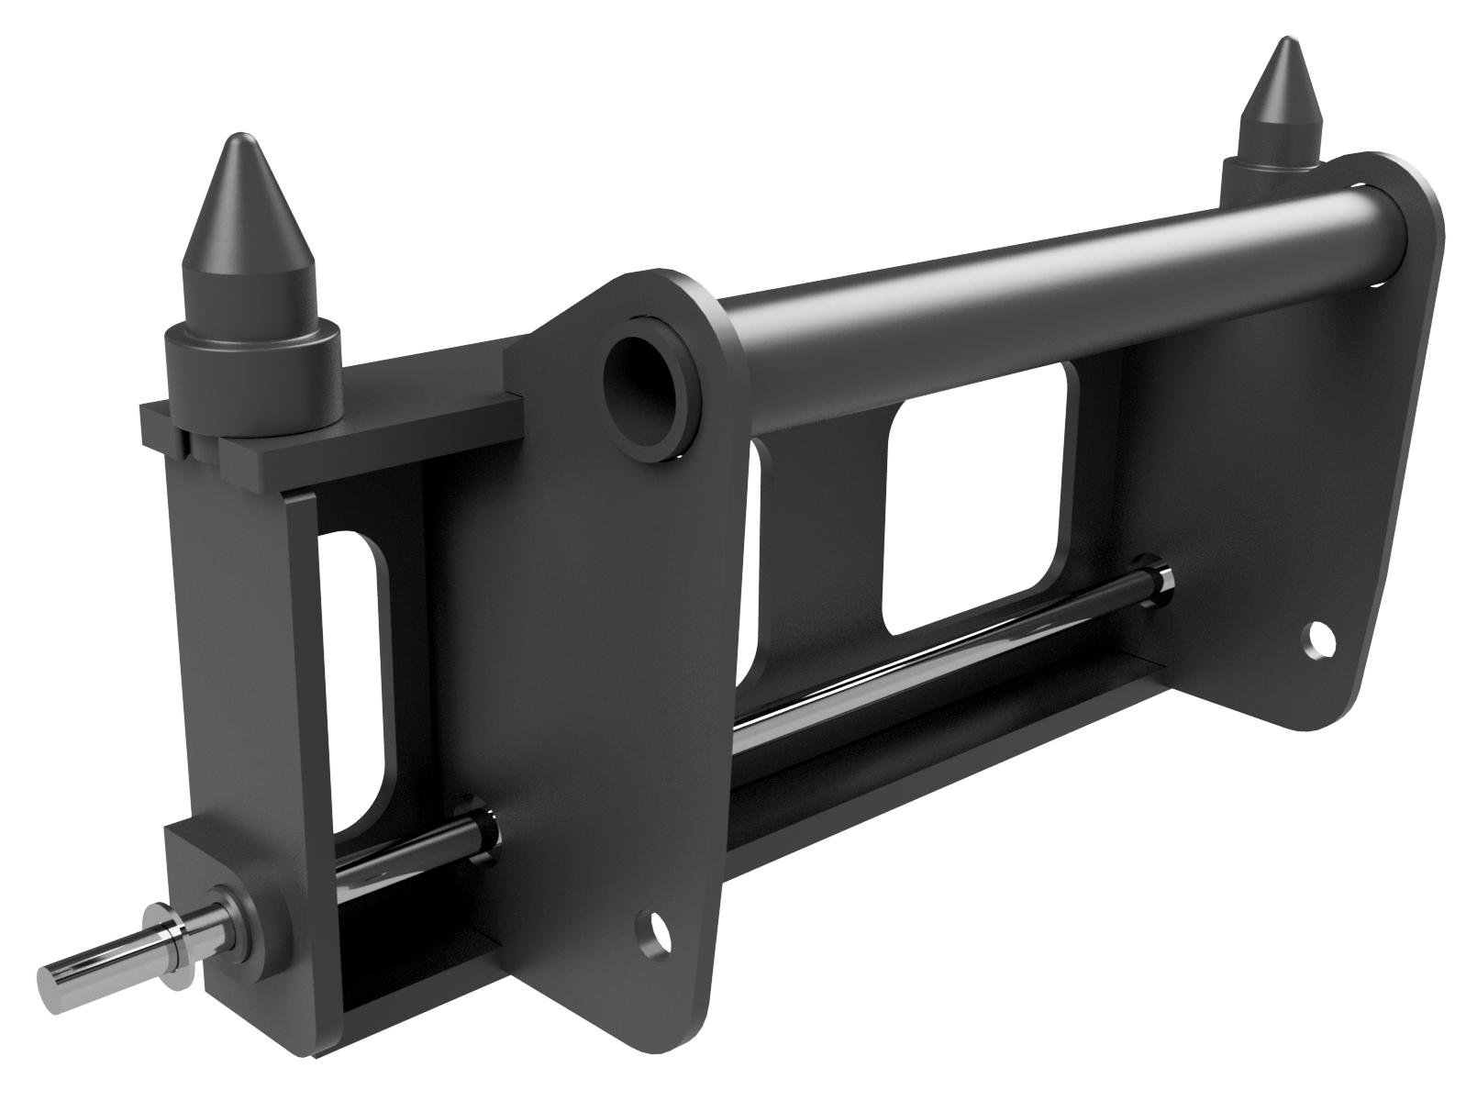




HEADSTOCKS
& ADAPTOR
PLATES
FEATURES
Hydraulic or manual locking
Designed to maximise host machine schematics
Trusted by OEMs globally
Popular models held in stock
WHITES MATERIAL HANDLING
17 - 19 EMERY ROAD
BRISTOL
BS4 5PF
0117 972 0006
WWW.WHITESMH.CO.UK
SALES@WHITESMH.CO.UK

