Slide 1

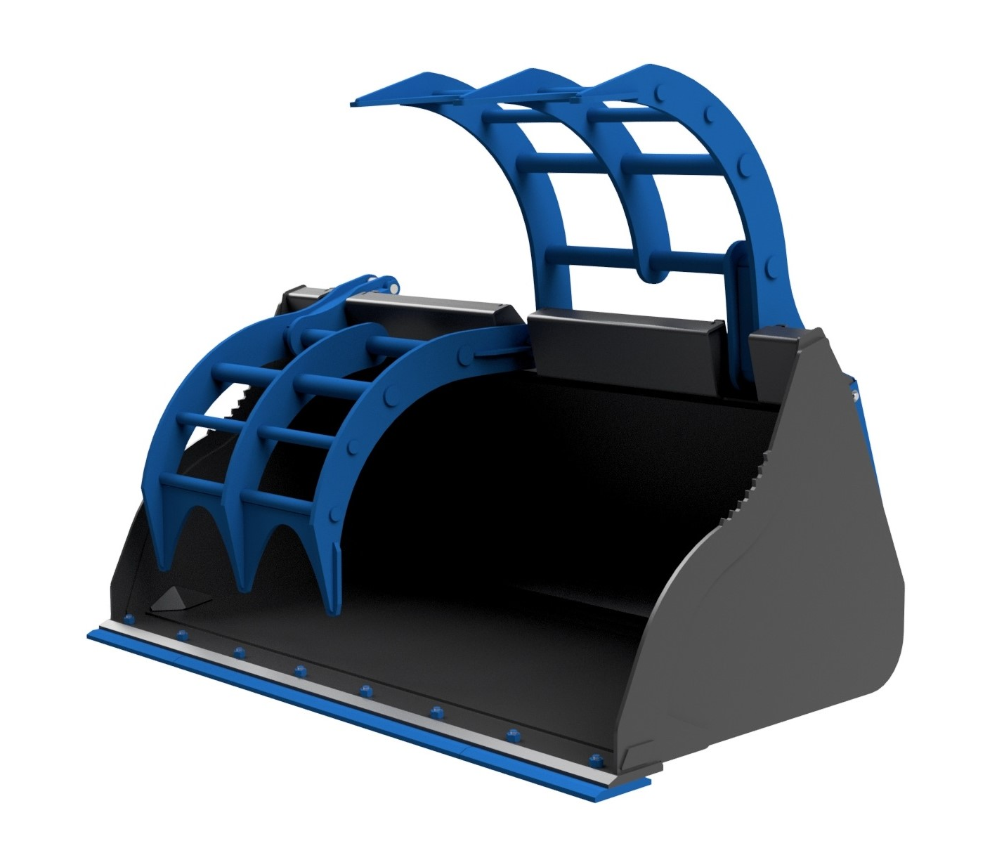
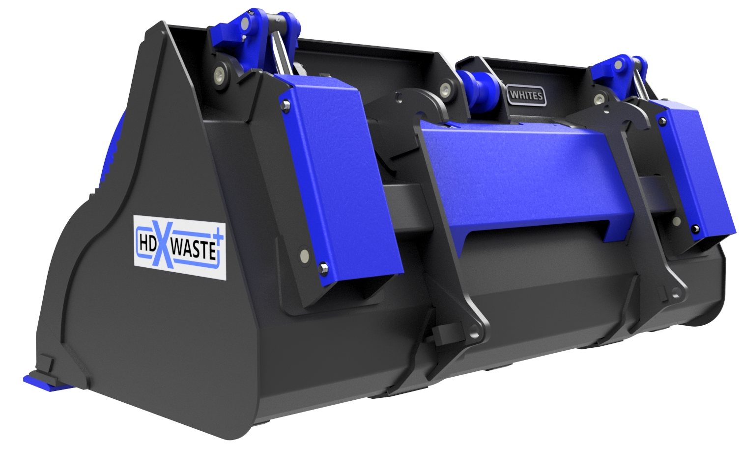





HDX WASTE+ BUCKET
GRABS
FEATURES
Ultra heavy duty specification
Raex heavy duty split grab
8mm shell and sides
Ram protection covers
Ram cushioning
Covering to protect hoses and valve
Serrated edging for pole/log handling
Open and close grab stops for ram and pin protection
HB500 welded cutting edge
HB500 3 piece bolt on reversible toe plate
HB500 underside wear pads & side cutters
High capacity hydraulic cylinders
Fully wrapped brackets and bracket pads
Rolled bucket shell to prevent materials sticking
High grade pins and bushes
Supplied with brackets for your machine
Model | Width | Capacity
GXP1776 | 7’6’’ | 1.70m3
GXP2076 | 7’6’’ | 2.00m3
GXP1780 | 8’ | 1.75m3
GXP2380 | 8’ | 2.30m3
GXP2588 | 8’8’’ | 2.50m3
WHITES MATERIAL HANDLING
17 - 19 EMERY ROAD
BRISTOL
BS4 5PF
0117 972 0006
WWW.WHITESMH.CO.UK
SALES@WHITESMH.CO.UK

