Slide 1

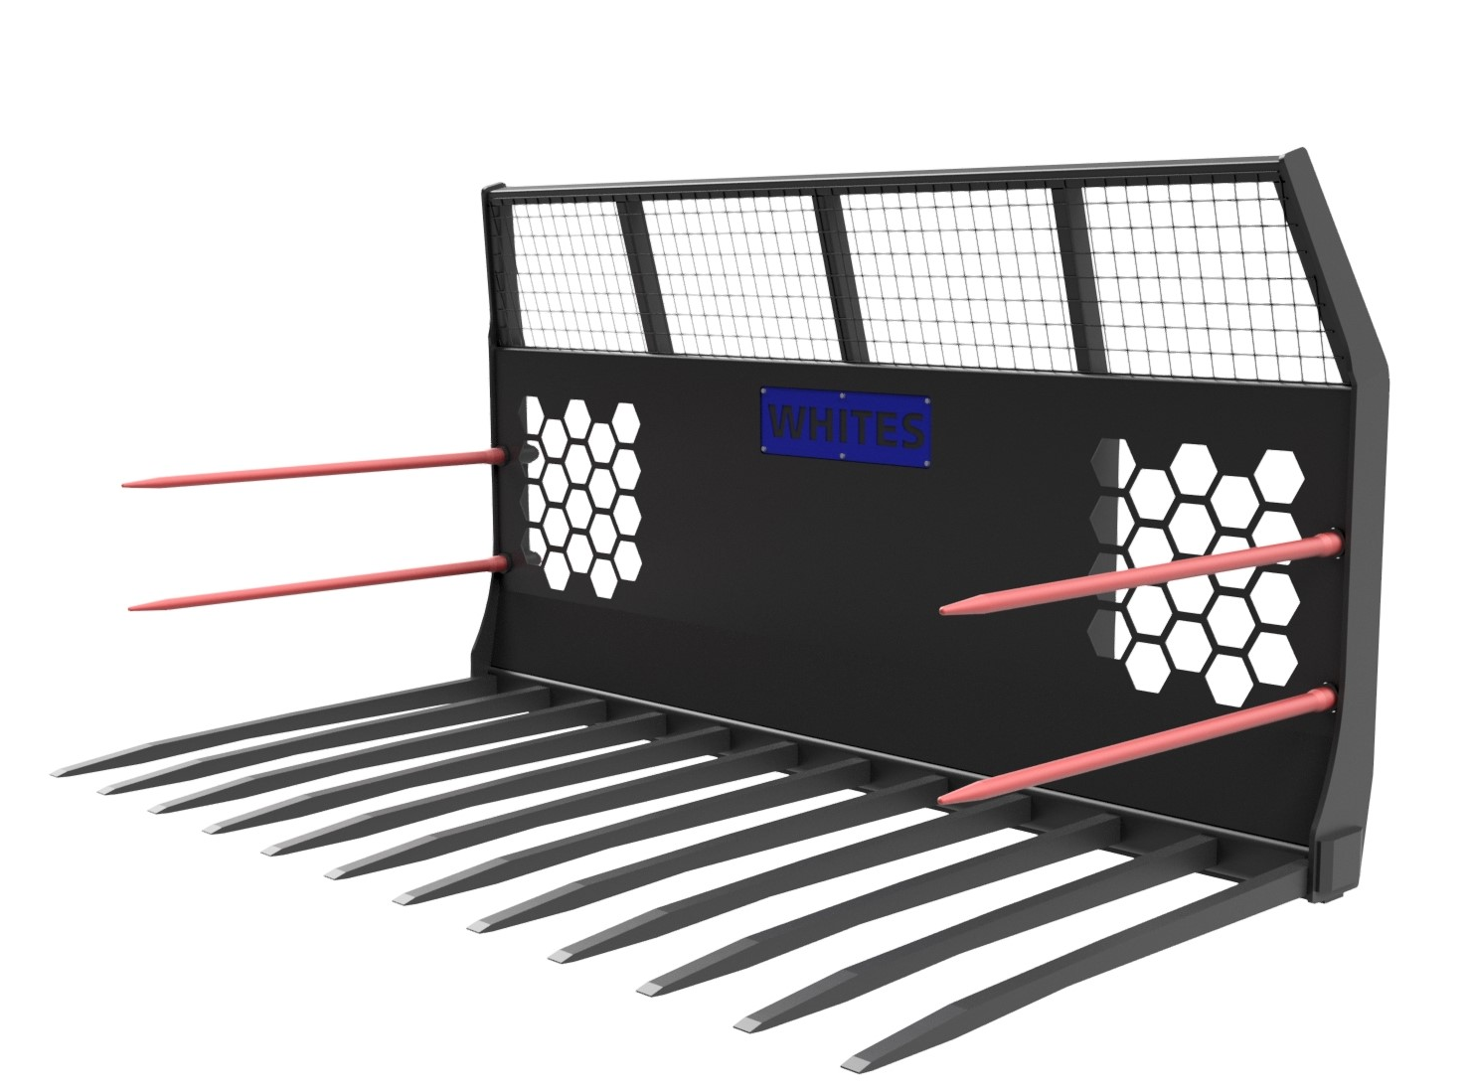
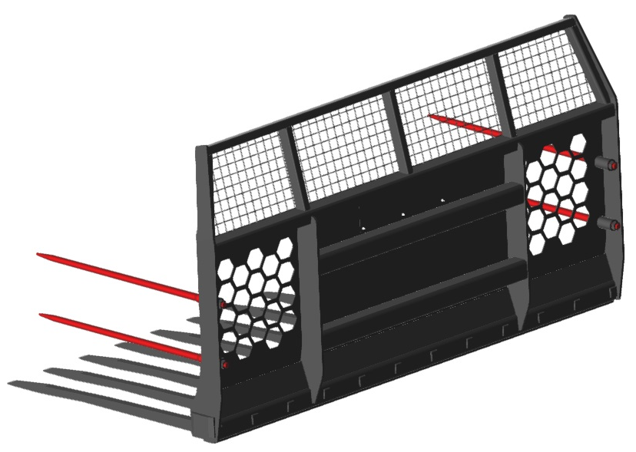





GRASS FORKS
FEATURES
1400mm long Hardox tines
Full width underside wear strip
HB500 side wear pads for wall protection
Large visibility slots
Weldmesh spill guard
Double side tines
Angled plates to prevent grass build up
Bolt on Brackets
Optional personalised nameplate
Model | Width | Capacity | Tines
GF80HX | 8’ | 4.50m3 | Hardox
GF90HX | 9’ | 5.15m3 | Hardox
GF10HX | 10’ | 5.70m3 | Hardox
WHITES MATERIAL HANDLING
17- 19 EMERY ROAD
BRISTOL
BS4 5PF
0117 972 0006
WWW.WHITESMH.CO.UK
SALES@WHITESMH.CO.UK

