Slide 1

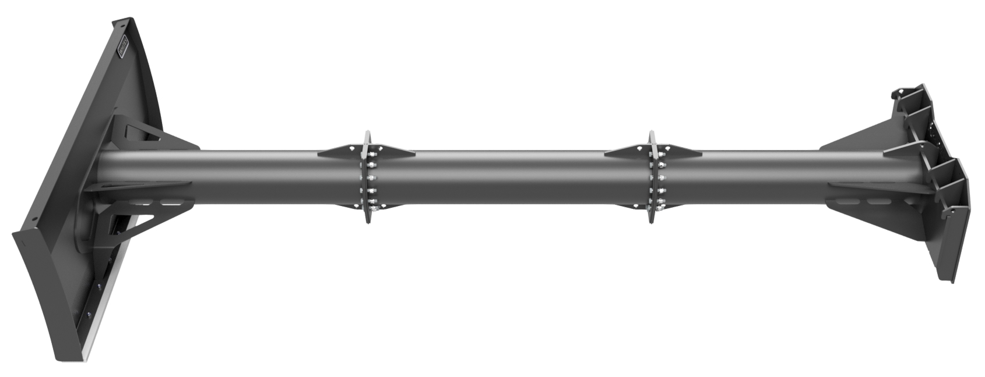
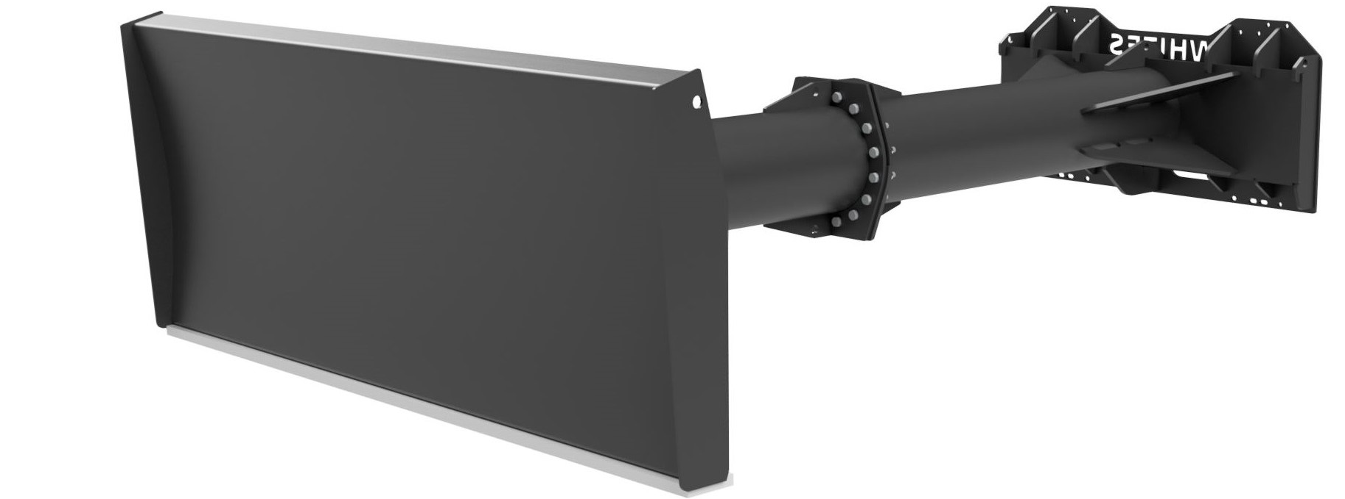
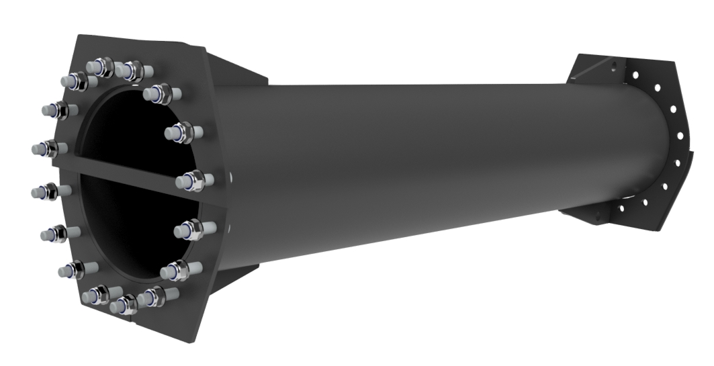





GRAIN
PUSHERS
FEATURES
10ft, 12ft and 14ft models
Bolt together design - length can be added
Optional 3' and 6' bolt in extensions
Single tube design - less grain traps
2450mm x 1000mm front blade
Nylon wear strip
Bolt on bracket options
Model | Length | Width
GD8010 | 10’ | 8’
GD8012 | 12’ | 8’
GD8014 | 14’ | 8’
WHITES MATERIAL HANDLING
17 - 19 EMERY ROAD
BRISTOL
BS4 5PF
0117 972 0006
WWW.WHITESMH.CO.UK
SALES@WHITESMH.CO.UK

