Slide 1

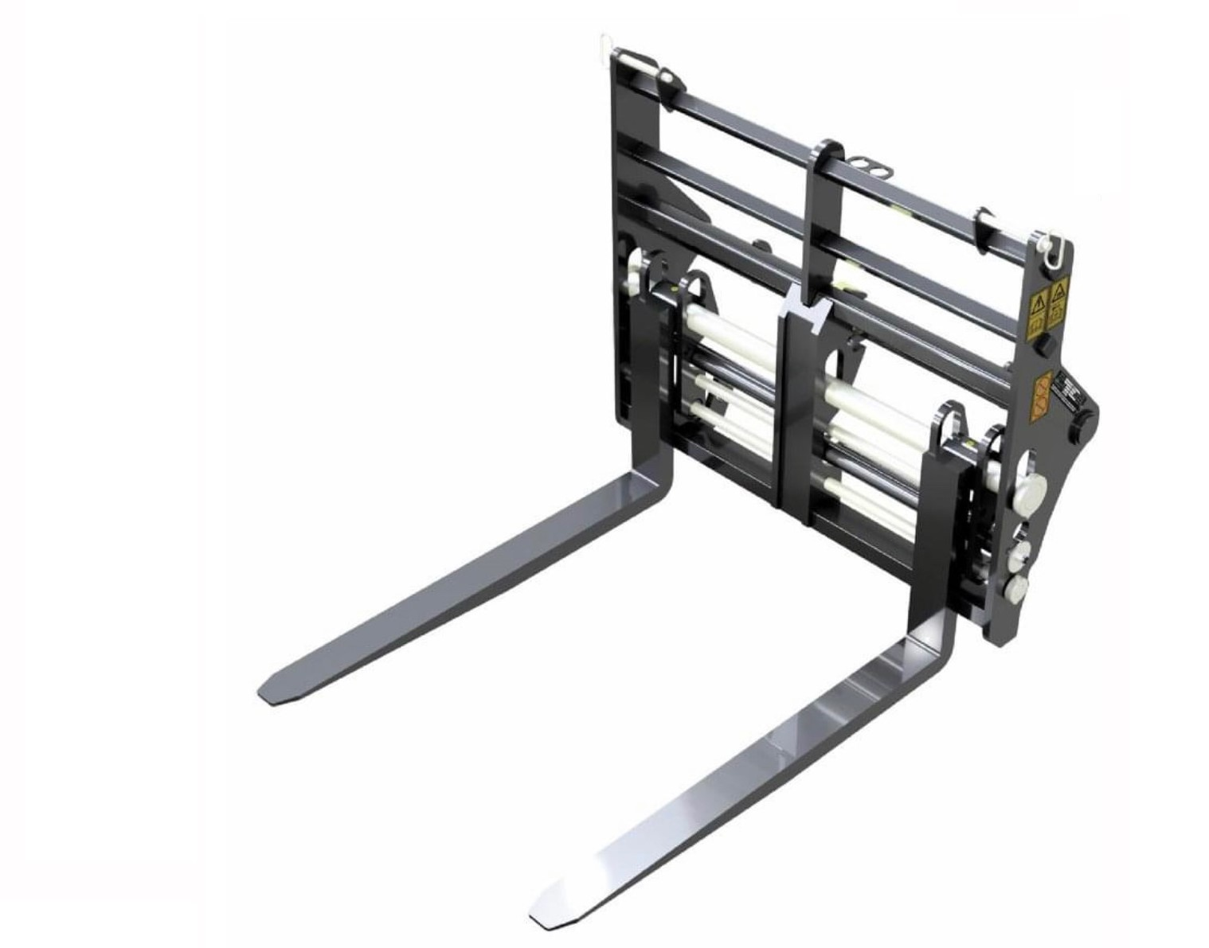




HYDRAULIC
FORK POSITIONER
FEATURES
Allows the safe movement of pallet forks - sideways and distance apart
Floating forks on bar
Integrated bracket design
Full height load guard
Fork retainers for safe road transport
Flow divider valve for equal fork movement
WHITES MATERIAL HANDLING
17 - 19 EMERY ROAD
BRISTOL
BS4 5PF
0117 972 0006
WWW.WHITESMH.CO.UK
SALES@WHITESMH.CO.UK

