Slide 1

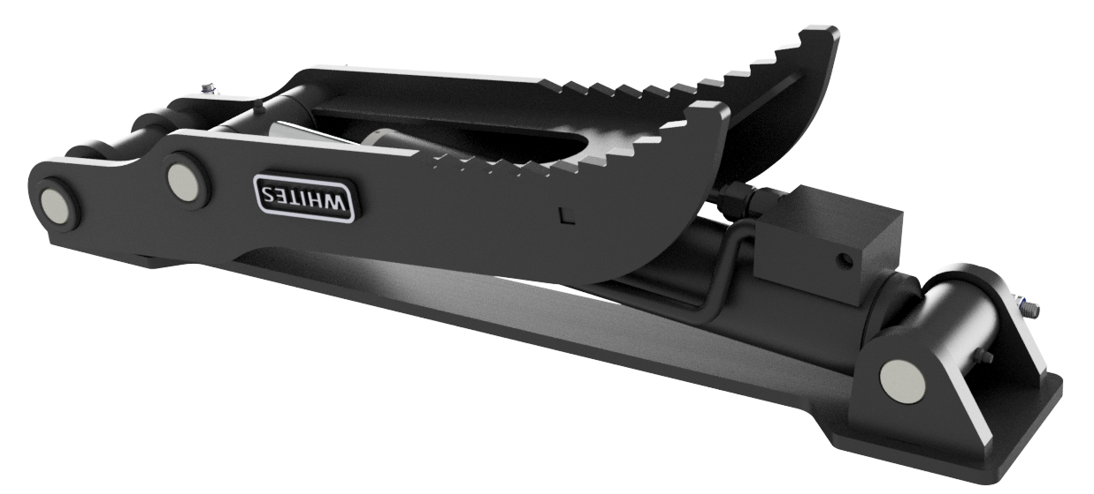
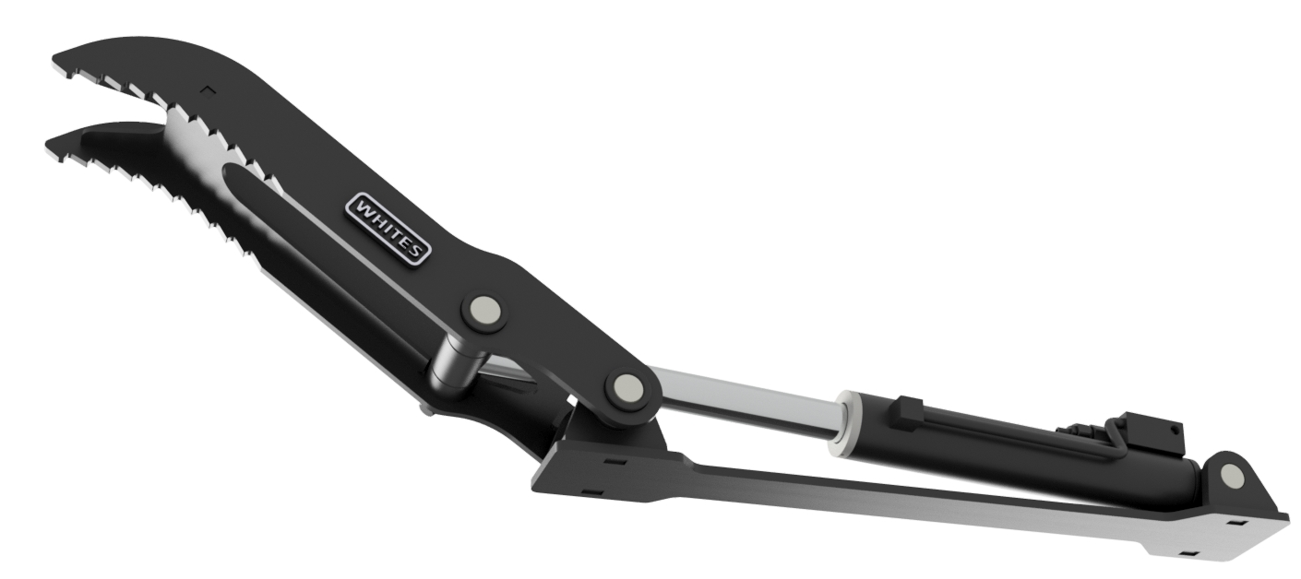




HYDRAULIC
THUMBS
FEATURES
Pressure relief valve
Universal fitment
Large rotational angle
Folds back when not in use
Model | Weight Range
TH08 | 0.75-1.5 TONNE
TH15 | 1-2 TONNE
TH30 | 2-4 TONNE
TH50 | 4-6 TONNE
TH70 | 6-9 TONNE
WHITES MATERIAL HANDLING
17 - 19 EMERY ROAD
BRISTOL
BS4 5PF
0117 972 0006
WWW.WHITESMH.CO.UK
SALES@WHITESMH.CO.UK

