Slide 1

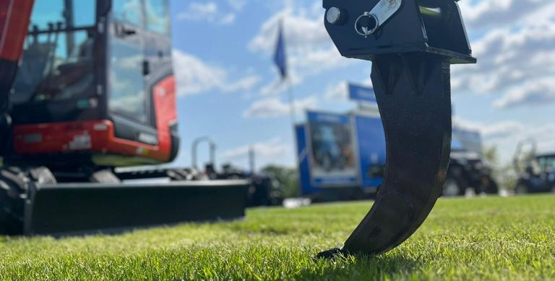
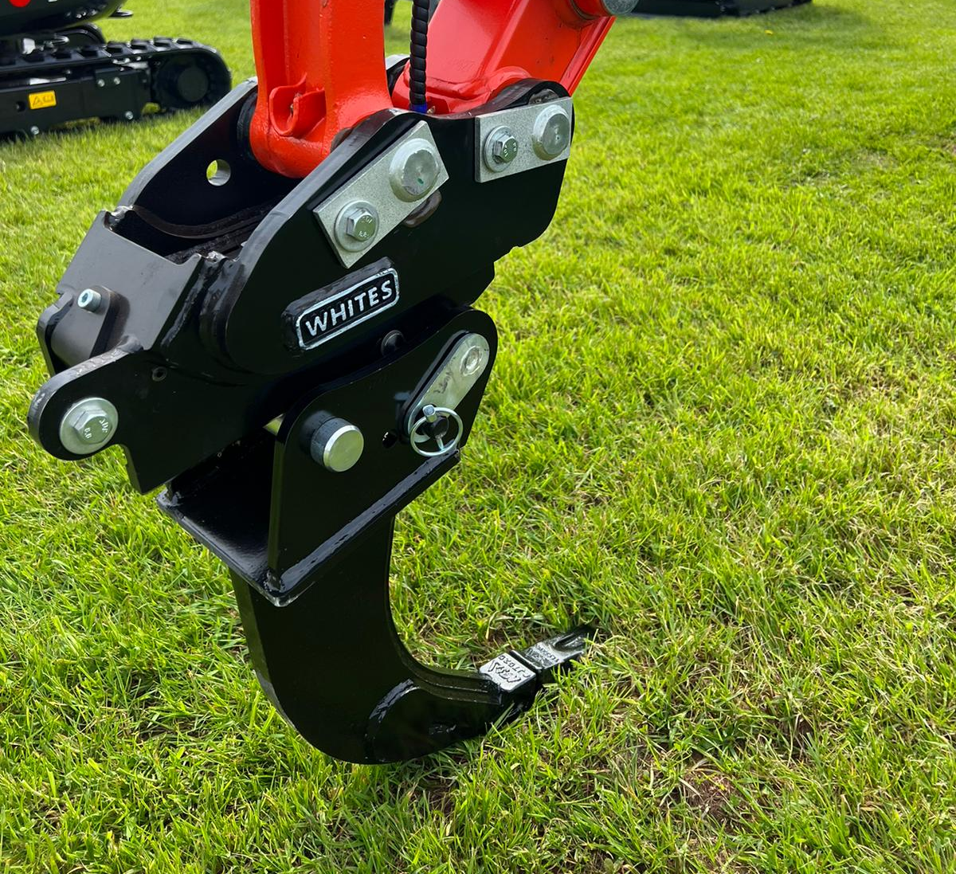

EXCAVATOR
RIPPER
TEETH
FEATURES
Ideal for breaking up concrete, tarmac and other dense materials
Models for 0.75T to 21.0T machines
Manufactured to OEM standards
Supplied with replaceable CAT tooth
High tensile steel strengthening supports
WHITES MATERIAL HANDLING
17 - 19 EMERY ROAD
BRISTOL
BS4 5PF
0117 972 0006
WWW.WHITESMH.CO.UK
SALES@WHITESMH.CO.UK

