Slide 1

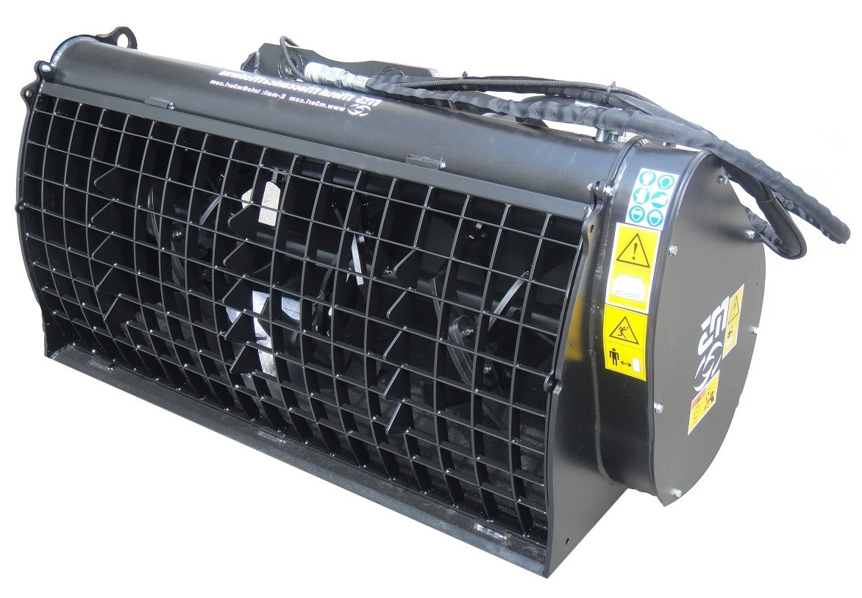




CONCRETE
MIXING BUCKETS
FEATURES
HB400 helix
Side or central discharge options
Fully protected hydraulic motor
Polyurethane seals
Rounded safety grill
Chain tensioner
Model | BM15 | BM200 | BM 250E | BM250 | BM350 | BM450 | BM600 | BM700 | BM 1100 | BM 1500 | BM 2000
Width (mm) | 1260 | 1260 | 1480 | 1480 | 1580 | 1630 | 1900 | 1900 | 2150 | 2250 | 2750
Cap. (L) | 150 | 200 | 250 | 250 | 350 | 450 | 600 | 700 | 1100 | 1500 | 2000
Max Cap. | 175 | 250 | 300 | 300 | 400 | 550 | 800 | 900 | 1400 | 1600 | 2250
Trans-mission | Gear | Gear | Gear | Chain | Chain | Chain | Chain | Chain | Chain | Chain 2 Motor | Chain 2 Motor
Weight (KG) | 260 | 275 | 380 | 380 | 425 | 450 | 630 | 750 | 1000 | 1700 | 2100
Flow Rate | 25 | 25 | 40 | 40 | 50 | 70 | 75 | 75 | 110 | 200 | 200
Max LT. Cap. | 40 | 40 | 75 | 90 | 90 | 90 | 115 | 150 | 151 | 250 | 250
Working Pressre. | 140 | 140 | 160 | 160 | 160 | 160 | 160 | 160 | 190 | 200 | 200
Max. Pressre. | 160 | 160 | 200 | 241 | 241 | 241 | 200 | 200 | 225 | 225 | 225
WHITES MATERIAL HANDLING
0117 972 0006
WWW.WHITESMH.CO.UK
SALES@WHITESMH.CO.UK

