Slide 1

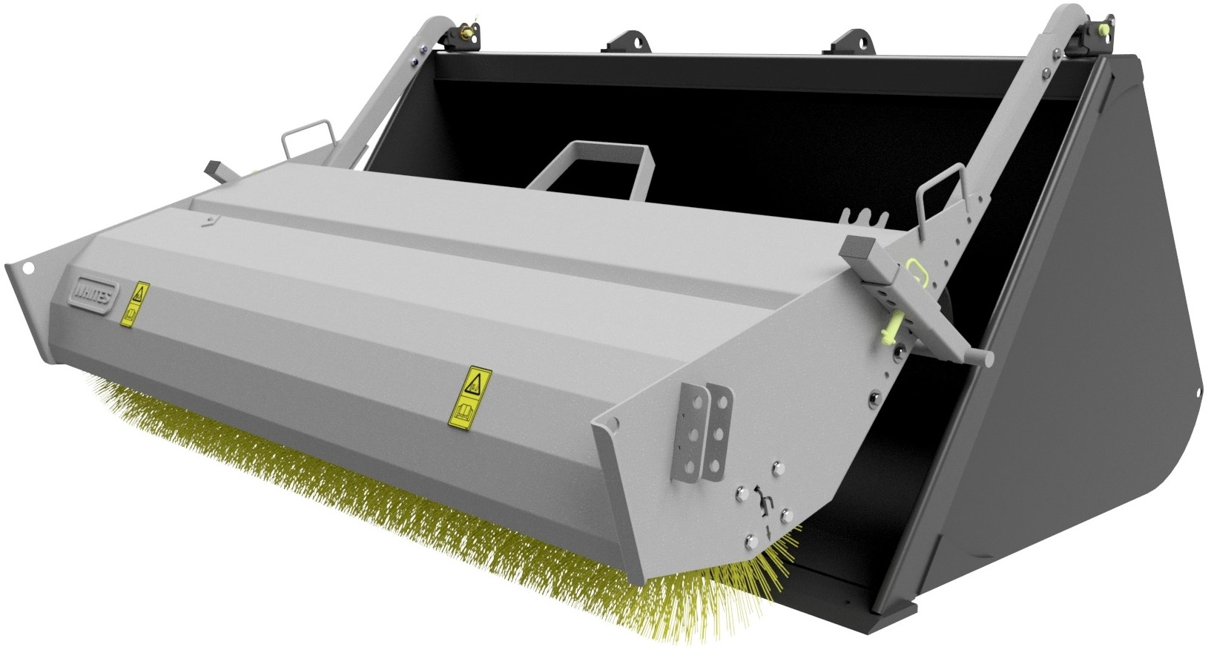





BUCKET
BRUSHES
FEATURES
Models to suit buckets from 5’6’’ to 8’ wide
Suitable for most Bucket brands
Galvanized canopy
Heavy duty bristles
Hose parking slot
Adjustable arms and jack legs
Clip and go system inc. safety pin; quick, easy & safe
Motor protection valve fitted as standard
Stands upright when not in use
Optional folding storage legs
WHITES MATERIAL HANDLING
17 - 19 EMERY ROAD
BRISTOL
BS4 5PF
0117 972 0006
WWW.WHITESMH.CO.UK
SALES@WHITESMH.CO.UK

Slide 2
