Slide 1

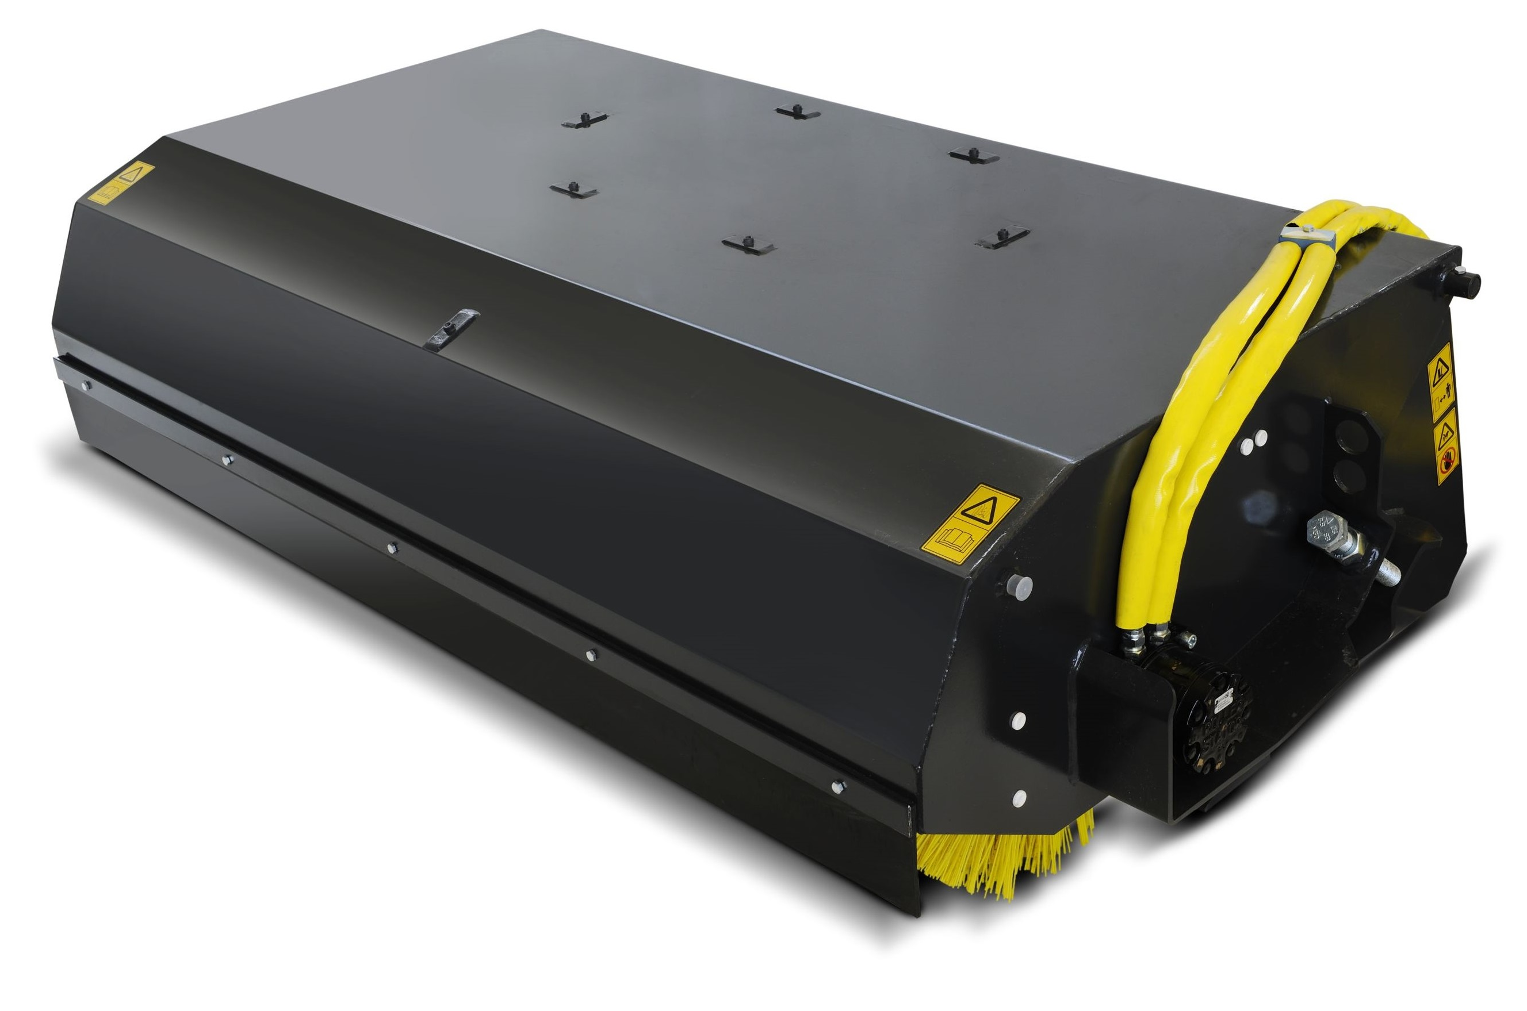





BROOM
BUCKETS
FEATURES
Heavy duty construction
Powerful direct drive motor
Large diameter shafts and bearings for long trouble free life
Supplied with polypropylene bristles as standard, poly-wire mix optional
Choice of bristle materials available
Optional bolt on reversible cutting edge
Minimum flow required please apply for
Dust suppression kit available
WHITES MATERIAL HANDLING
17 - 19 EMERY ROAD
BRISTOL
BS4 5PF
0117 972 0006
WWW.WHITESMH.CO.UK
SALES@WHITESMH.CO.UK

