Slide 1
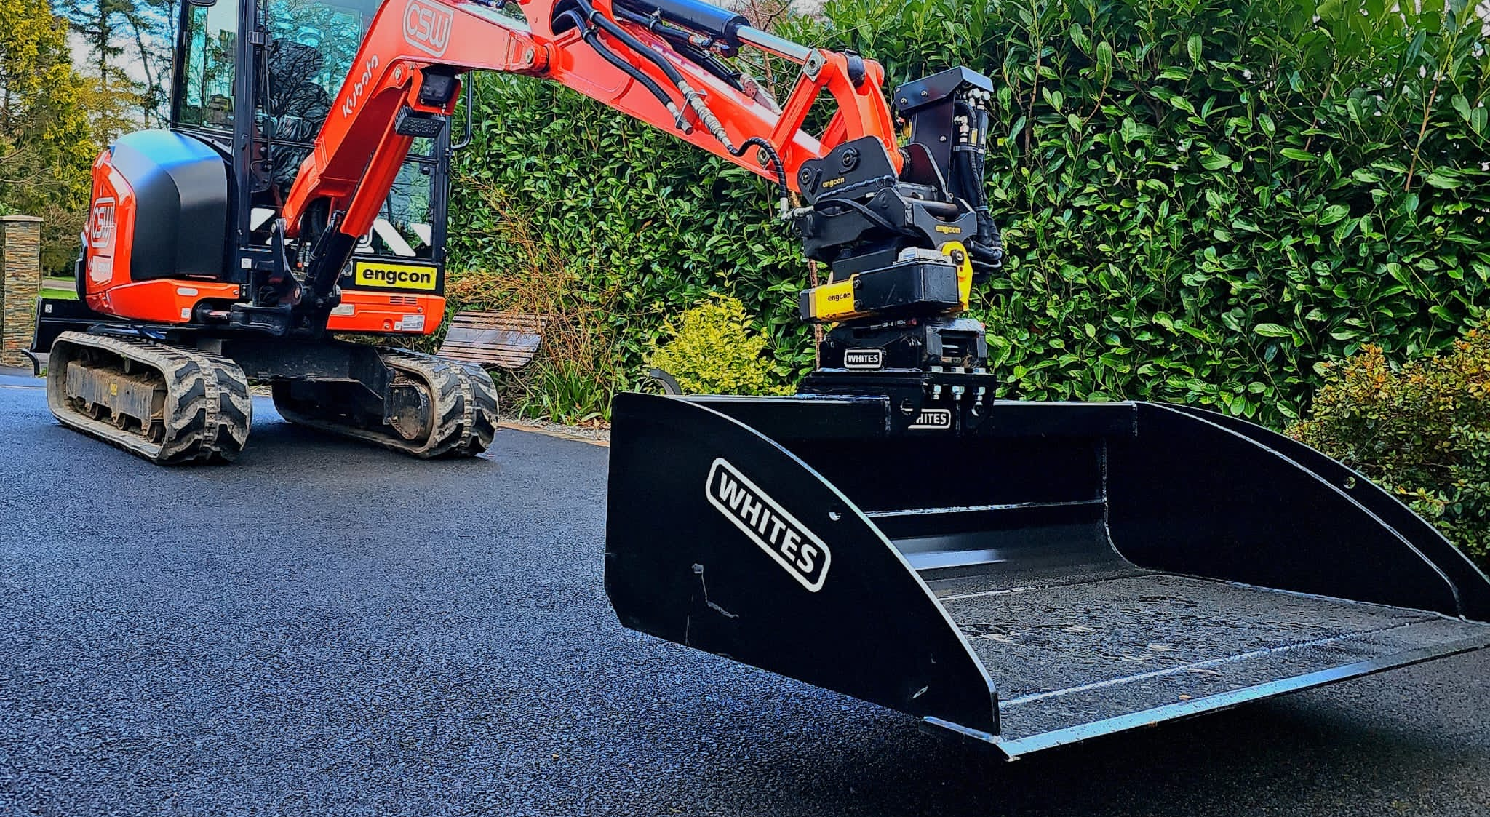

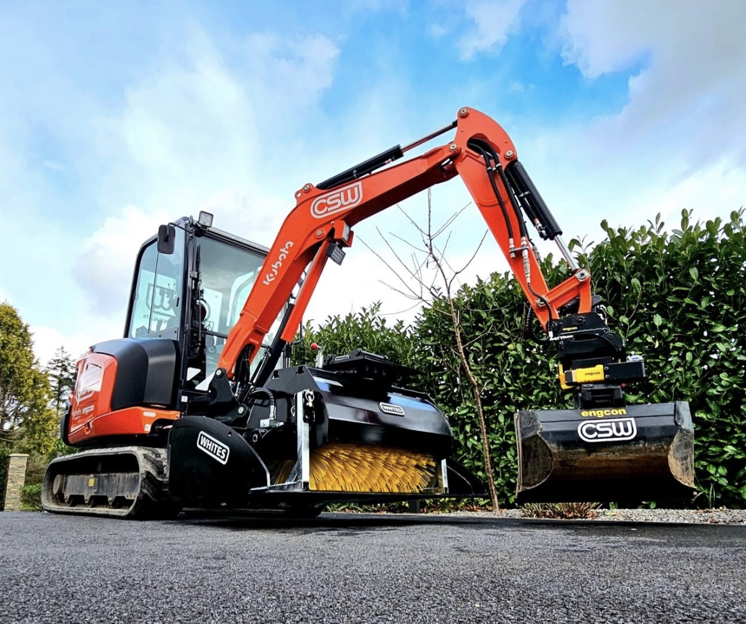

BLADE
RUNNER
FEATURES
Add versatility to your machine
Connects via blade or direct mount to coupler / machine
Universal fitment
Safely transport buckets / attachments & products
Safely store your Tiltrotator
WHITES MATERIAL HANDLING
17 - 19 EMERY ROAD
BRISTOL
BS4 5PF
0117 972 0006
WWW.WHITESMH.CO.UK
SALES@WHITESMH.CO.UK

Slide 2
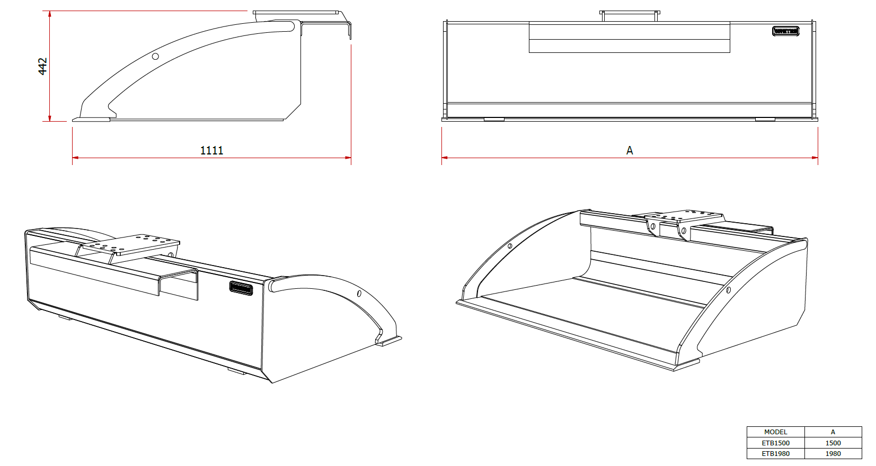
BLADE
RUNNER
WHITES MATERIAL HANDLING
17 - 19 EMERY ROAD
BRISTOL
BS4 5PF
0117 972 0006
WWW.WHITESMH.CO.UK
SALES@WHITESMH.CO.UK

