Slide 1


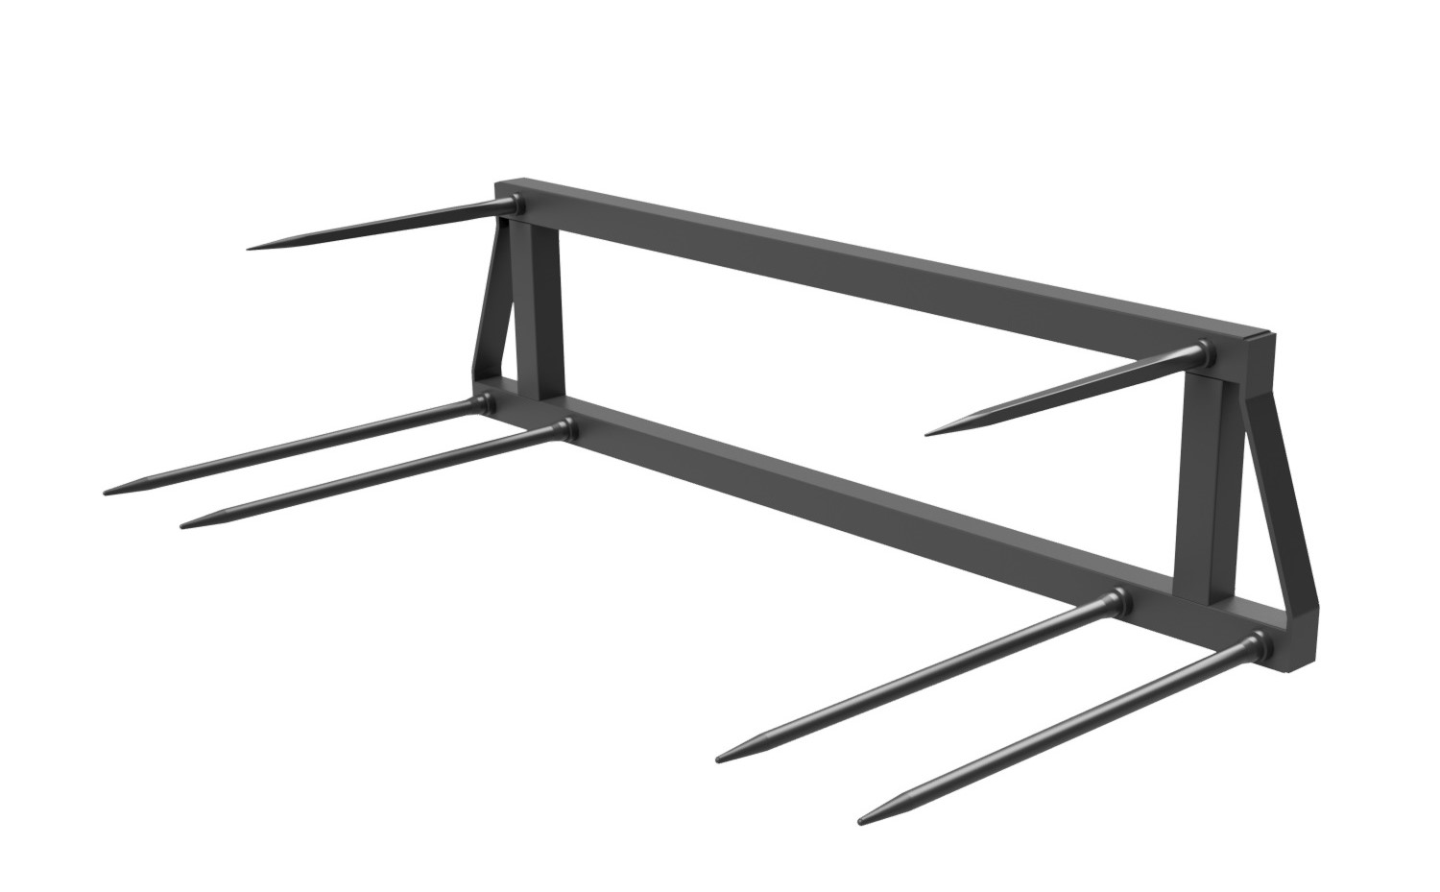
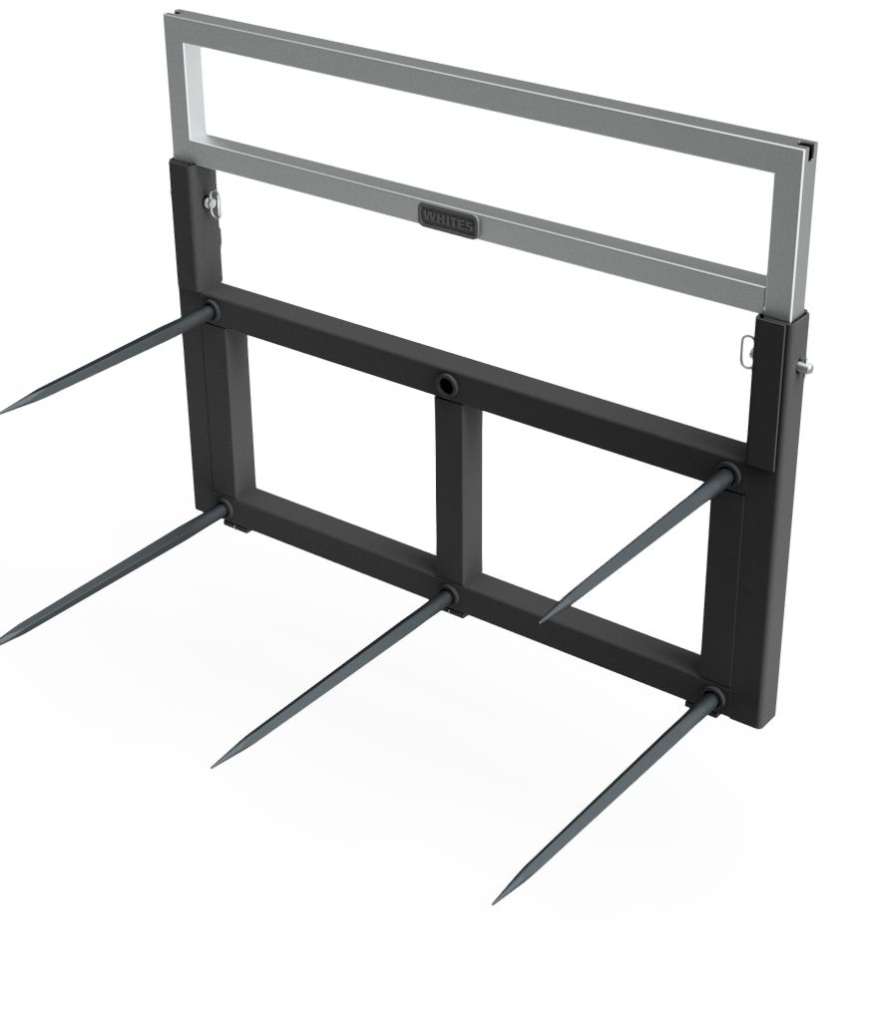
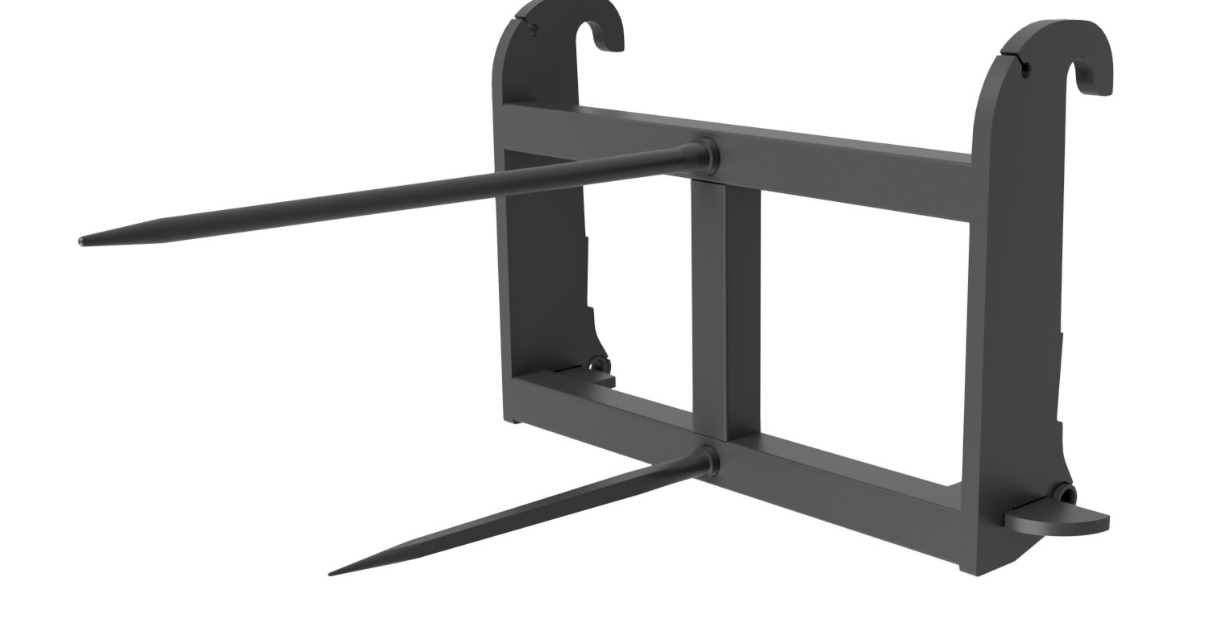




BALE
SPIKES
FEATURES
Heavy box section construction
Bushed tines
Supplied with mounting brackets
BS6K c/w adjustable extension 1290mm > 1950mm
Model | Tines | Rounds | Squares
BS2K | 2 | 1 | 1
BS4K | 6 | 2 | 1
BS5E | 5 | 2 | 2/3
WHITES MATERIAL HANDLING
17 - 19 EMERY ROAD
BRISTOL
BS4 5PF
0117 972 0006
WWW.WHITESMH.CO.UK
SALES@WHITESMH.CO.UK

