Slide 1

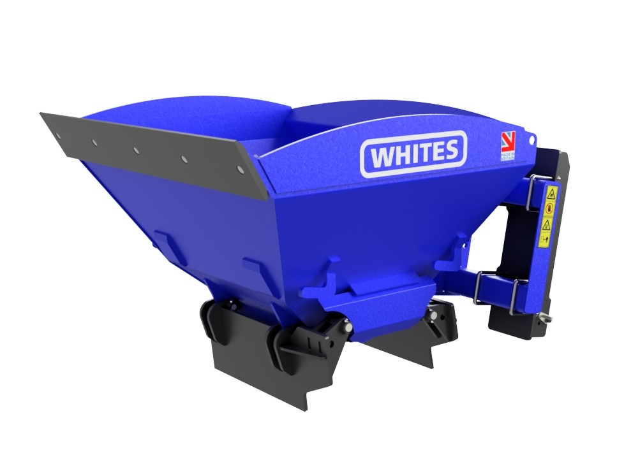






BAG-X
BAG FILLING
BUCKET
FEATURES
Load up to 45 bags per hour
Ideal for sand, stone, aggregates, gravel
0.60m3
Horizonal ram - no chain system
Ram guard
Curved sides & guard provide spill protection
Angled doors with side spill protection
HB500 cutting edge and wear pads
HB500 bolt on reversible toe plate
Internal bucket gussets
QRC parking slots
Bolt on brackets
WHITES MATERIAL HANDLING
17 - 19 EMERY ROAD
BRISTOL
BS4 5PF
0117 972 0006
WWW.WHITESMH.CO.UK
SALES@WHITESMH.CO.UK

