Slide 1

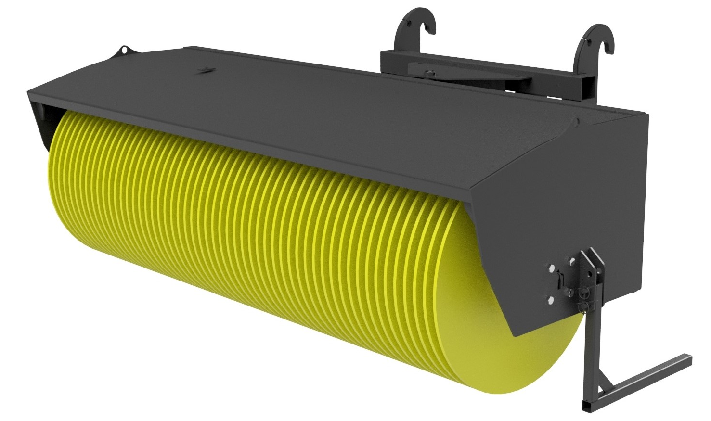
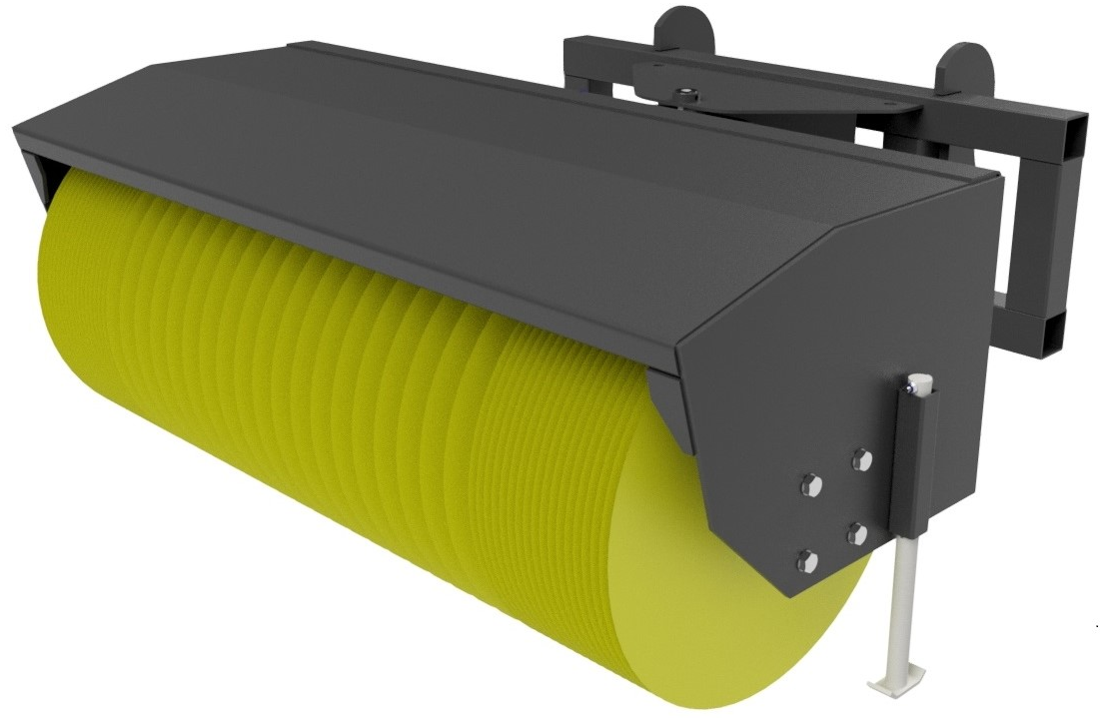





ANGLED
BROOM
FEATURES
Heavy duty construction
Great for Agricultural & Snow Clearing applications
Adjustable angle 30 deg left, 30 deg right
Powerful Bi Directional direct drive motor
Large over size bearing
Supplied with Polypropylene Bristles as standard
Storage legs included
WHITES MATERIAL HANDLING
17 - 19 EMERY ROAD
BRISTOL
BS4 5PF
0117 972 0006
WWW.WHITESMH.CO.UK
SALES@WHITESMH.CO.UK

