Slide 1

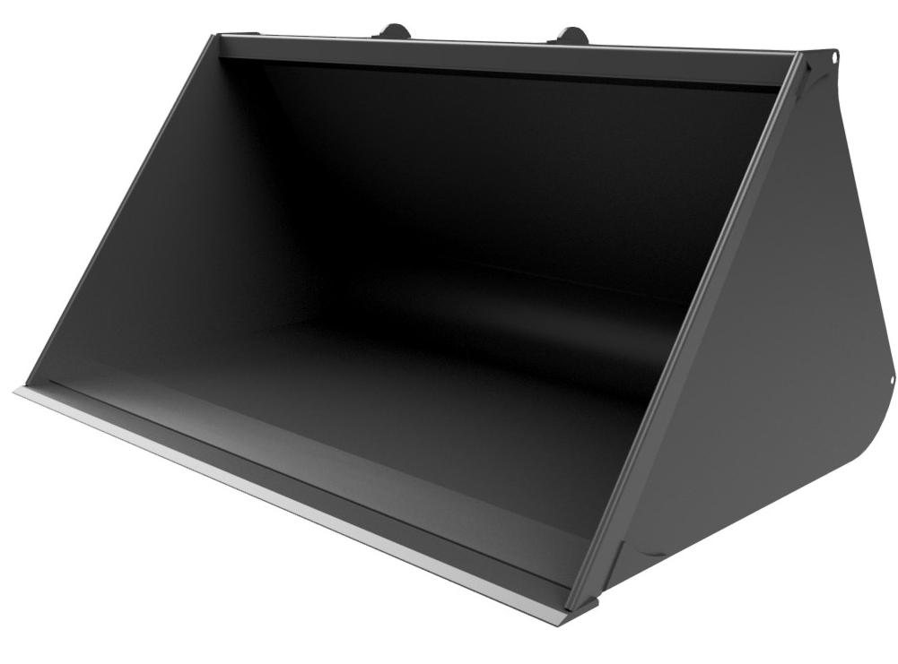







AGRICULTURAL
BUCKETS
FEATURES
6’ to 9’ wide
Sizes from 1.00m3 to 4.00m3
Strenx 700mc sides
Rolled bucket shell for optimal material discharge
Rolled side plates protect crop
HB500 weld on toe plate
HB500 underside wear pads
Fully wrapped bracket supports
Stepped floor increases bucket strength
Optimal bucket angle maximising crowd back ability
OEM approved design; trusted worldwide
Optional HB500 bolt on toe plate
WHITES MATERIAL HANDLING
17 - 19 EMERY ROAD
BRISTOL
BS4 5PF
0117 972 0006
WWW.WHITESMH.CO.UK
SALES@WHITESMH.CO.UK

